Slide 1

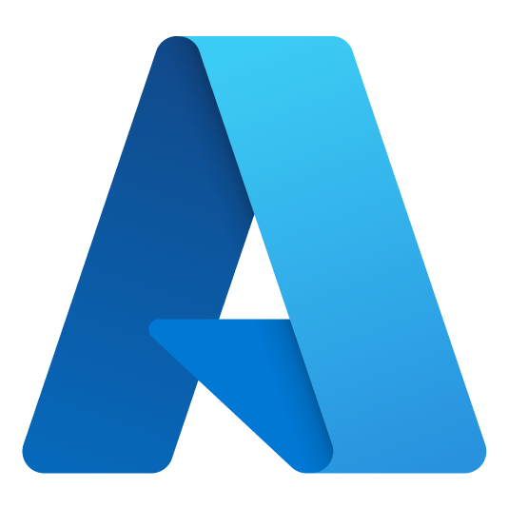



Jim Blizzard
Cloud Solution Architect
Azure Dev Day
jim.blizzard@microsoft.com
https://www.linkedin.com/in/jimblizzard/
https://github.com/jimblizzard

Slide 2

DevOps with GitHub
Making the DevOps easier, faster, and more cost-effective with Azure and GitHub.
+
Notes:
“DevOps is the union of
people,
process, and
products to enable
continuous delivery of value to our end users.”

Slide 3
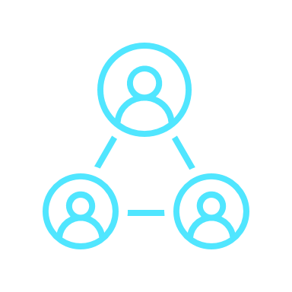
Azure
DevOps Phases
Plan
Develop
Collaborate
Deliver
Operate
Notes:
“DevOps is the union of people, process, and products to enable continuous delivery of value to our end users.”
Let’s talk about the different phases that make up DevOps and tools for each phase.
Plan & Track – GitHub Issues and Project planning
Develop -- Use whatever development environment you need
Collaborate -- you can Manage Source Code, Branches, Pull Requests, Issues, Discussions
Deliver -- you can use GitHub Actions to Build, Test, Package, Deploy to on prem or the cloud.
including INFRASTRUCTURE AS CODE.
Operate, Monitor & Learn -- Monitoring telemetry from your systems and these tools.
This all becomes a cycle. As we go from one phase to the next, we want to be learning and folding our learnings back into our next round of plans.

Slide 4

Why did Microsoft Acquire GitHub?

Slide 5
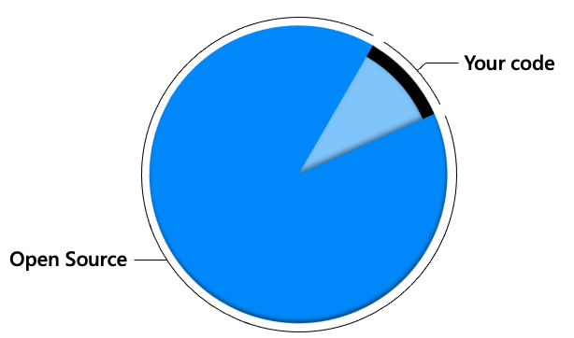

Modern enterprise applications
Notes:
In modern enterprise apps, 90% of the code comes from open source <click>
And <click> most of that lives in GitHub which has the world’s largest developer community

Slide 6
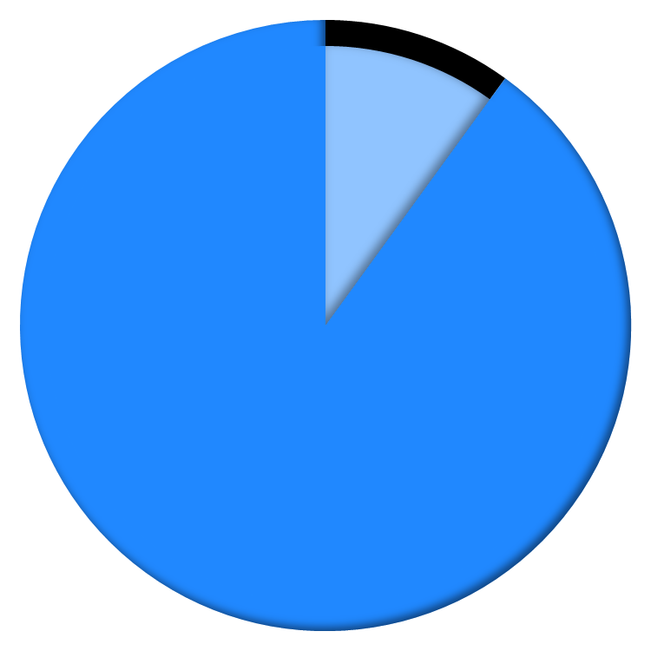


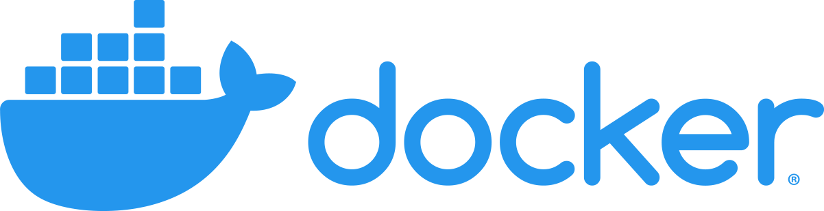

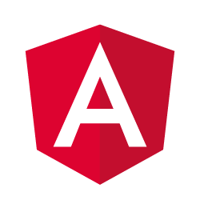
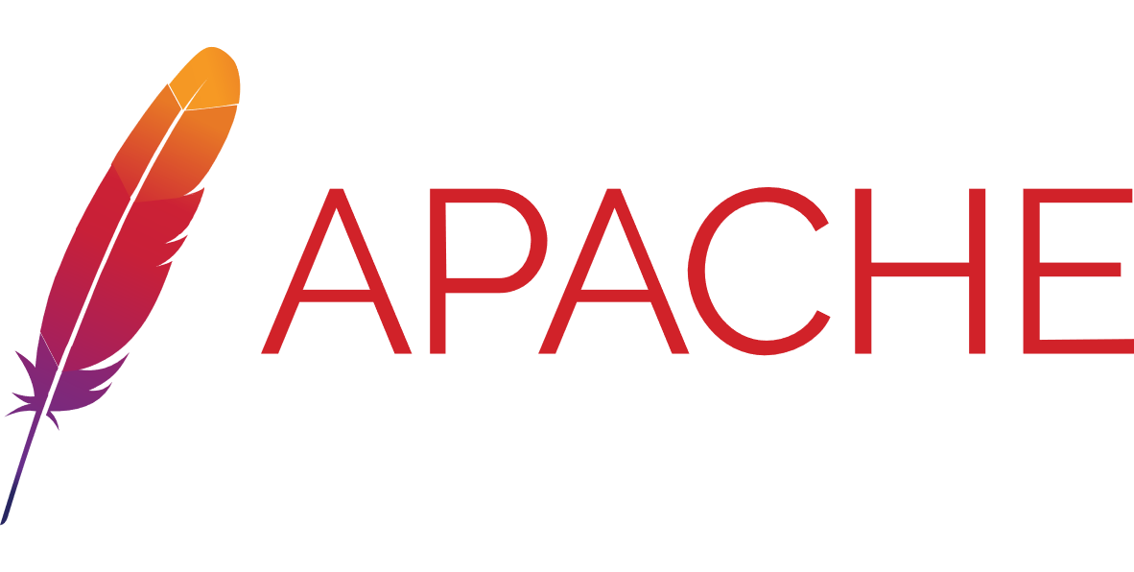


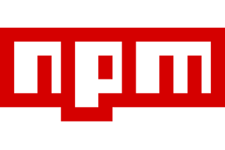
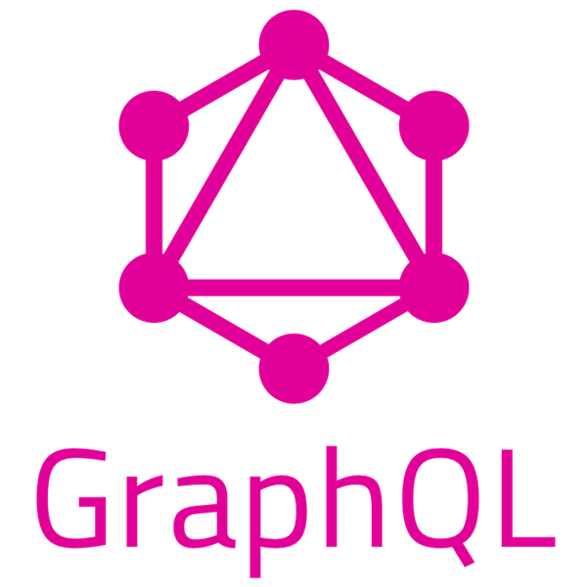
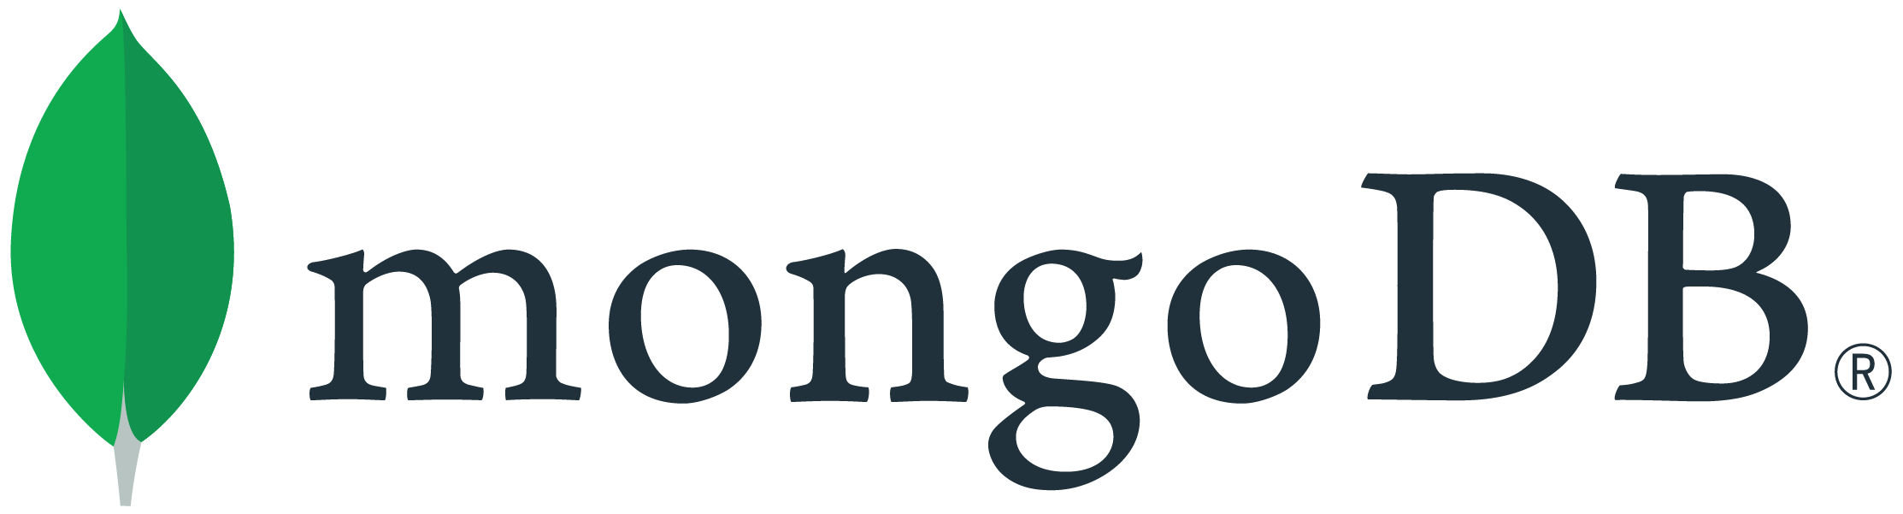
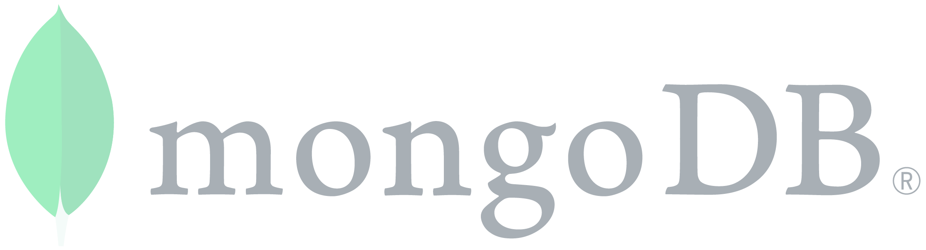
In modern enterprise applications 90% of the code comes from open source
Your code
Open Source
Most of that code lives on GitHub
MICROSOFT CONFIDENTIAL – SHARED UNDER NDA
Source: 2019 Synopsys Open Source Security report
Notes:
[Shanku] 90% of the code in new apps comes from open source. In fact, we find that on average projects have dependencies that rely on the works of more than 10 thousand developers And most of that code, and most of those developers, [CLICK] are on GitHub, and we help you collaborate with them.
And of course, even in your own organizations...

Slide 7


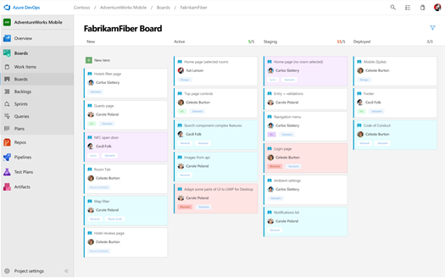
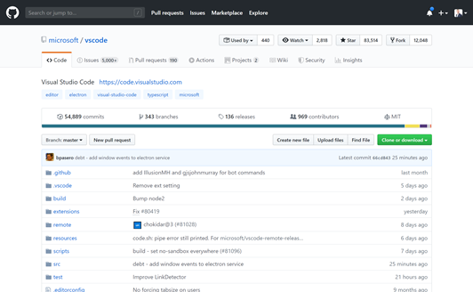
Microsoft is now committed to the world’s largest developer community
Azure DevOps
Empowering 1000s of enterprises
15+ years of developer innovation
GitHub
The home of open source software
65 million+ users
https://github.com/about
Notes:
We have Azure DevOps today, which has been incredibly successful. It empowers thousands of our customers with over 15 years of innovation focused on enterprises in particular, That’s been the sweet spot for us.
So, Why GitHub?
Microsoft’s Mission Statement is to “Empower every person and every organization on the planet to achieve more”
[click]
GitHub’s Vision is to be “The home for all developers” and GitHub has more than 65+ Million users
By making strategic investments in GitHub we will enable those 65+ million users to achieve more for their organizations by making GitHub the home for their DevOps tools.

Slide 8
Innersource with GitHub
Enabling open source culture and best practices inside your organization
Increased collaboration
Breaking silos
Higher developer satisfaction
Notes:
GitHub is just a better platform for Innersource. Azure Repos is just not as good at discovering and sharing code across teams like Windows, Office, etc.
Increased collaboration between teams
Break down walls between teams, allowing people with experience to contribute to projects across the company
And surveys have shown that this leads to increased developer satisfaction

Slide 9
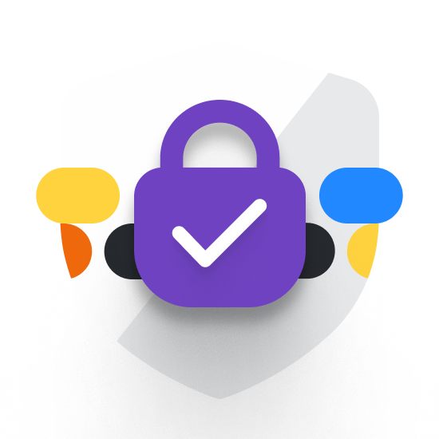


Secure the software lifecycle with GitHub
Dependency updates
Code scanning
Secret scanning
Included / GitHub Enterprise Cloud
GitHub Advanced Security (GHAS)
Notes:
With GitHub, we’re delivering a complete security offering.
We help you understand code dependencies, find vulnerable ones, and keep them up to date automatically, so you don’t end up with someone else’s vulnerable code.
Log4j vulnerability
With code scanning, we let you scan your own code, using CodeQL. CodeQL is used by many security research teams – including Google, Uber, and Microsoft – to keep some of the most used codebases in the world secure. And when you run code scanning, you’re querying your code for thousands of vulnerabilities – including the queries written by those security teams.
We scan your code for secrets, working with more than 20 providers to find passwords, keys, and other secrets, and take action.
NOTE: This is part of the GitHub Advanced Security (GHAS) SKU

Slide 10



Azure
DevOps Phases
Plan
Develop
Collaborate
Deliver
Operate
Azure Boards
GitHub Issues
GitHub Discussions
Visual Studio
Visual Studio Code
GitHub Codespaces
Azure Repos
GitHub Repos
GitHub Adv. Security
GitHub for Mobile
Azure Pipelines
Azure Test Plans
Azure Artifacts
GitHub Actions
GitHub Packages
Azure DevOps Dashboards & Reporting
GitHub Insights
Azure Monitor
Security Center AKS Azure Functions
App Service
Event Grid
MICROSOFT CONFIDENTIAL – SHARED UNDER NDA
Notes:
(We want to break Azure DevOps and GitHub down into tools for each DevOps Phase. Otherwise customers tend to say “I can’t use GitHub because it doesn’t have everything I need (e.g. Sprint Planning, Manual Approvals in Actions Workflows, etc.). )
Rather than just talking about Azure DevOps and GitHub, let’s talk about the different phases that make up DevOps and tools for each phase.
Plan & Track – Laying out your Epics, Features, User Stories and Tasks. Also tracking bugs
Develop –Using tools like Visual Studio Code to edit your code.
Collaborate – Managing Source Code, Ensuring your code plays nicely with everyone else’s code via Pull Requests
Deliver
Build – Using Centralized Build systems
Test – Running automated and manual tests and tracking their results
Release – Packaging your solutions for release
Deploy – Deploying your solutions to the cloud or on-prem
Operate, Monitor & Learn –Monitoring telemetry from your systems and these tools.
This all becomes a cycle. As you go from 1 phase to the next we want to be learning and folding our learnings back into our next round of plans.

Slide 11

The Value of Using GitHub Today

Slide 12
Secure your complete software lifecycle with GitHub
Dependency updates
Identify vulnerable dependencies, and update them to secure versions automatically
Code scanning
Scan your code for vulnerabilities, powered by CodeQL, and the work of the security research community
Secret scanning
Prevent secrets from leaking into code, including automatic remediation with 35+ providers
Included w/ GitHub Enterprise
GitHub Advanced Security (GHAS)
MICROSOFT CONFIDENTIAL – SHARED UNDER NDA
Notes:
Presentation tip: To keep the security conversation at a high level just use this slide. To go into more detail use the following 5 slides.
With GitHub, we’re delivering a complete security offering.
We help you understand your dependencies, find vulnerable ones, and keep them up to date automatically, so you don’t end up with someone else’s vulnerable code.
With code scanning, we let you scan your own code, using CodeQL. CodeQL is used by many security research teams – including Google, Uber, and Microsoft – to keep some of the most used codebases in the world secure. And when you run code scanning, you’re querying your code for thousands of vulnerabilities – including the queries written by those security teams.
We scan your code for secrets, working with more than 20 providers to find passwords, keys, and other secrets, and take action.
Martin, how about a demo?

Slide 13
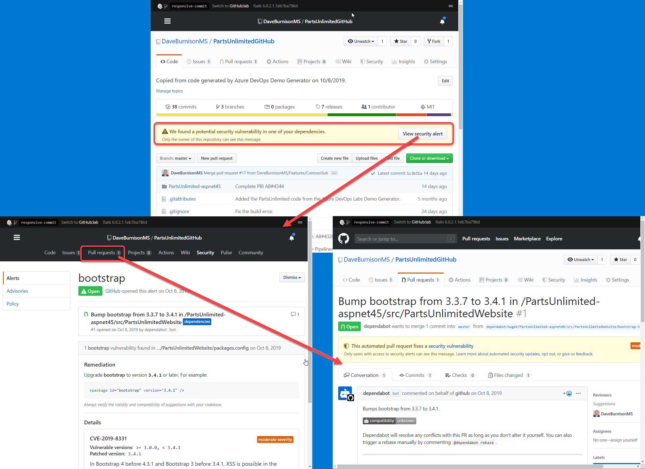
Dependency Scanning & Auto Security Updates - GitHub
Securing the software supply chain
Dependency graph
See the packages your project depends on, the repositories that depend on them, and any vulnerabilities detected in their dependencies.
Dependabot alerts
Get notified when there are new vulnerabilities affecting your repositories. GitHub detects and alerts users to vulnerable dependencies in public and private repos.
Dependabot security and version updates
Keep your supply chain secure and up-to-date by automatically opening pull requests that update vulnerable or out-of-date dependencies.
https://github.com/features/security
MICROSOFT CONFIDENTIAL – SHARED UNDER NDA
Notes:
NOTE: This is included with core GitHub.
Presenter Tip: After the animations build out, zoom in on the screenshots in the graphic 1 by 1 and walk through
The surfacing of the vulnerability
The details of the Dependabot alert including the CVE details.
The automatic creation of the PR by Dependabot
Acronyms
SAST = static application security testing
DAST – Dynamic application security testing
IAST – passive and active integrated security testing
RASP – runtime application security protection
SCA – fuzzy software composition analysis
This helps to automatically protect 100% of the code that you are deploying not just the 10% - 20% that your team is writing.
This automatically checks for known vulnerabilities as soon as you push code to GitHub, you do not have to add steps to your pipeline to do this. AND, when it finds a known vulnerability it automatically creates a Pull Request if it can find a resolution to the known vulnerability.
Rich vulnerability data: GitHub tracks vulnerabilities in packages from supported package managers using data from security researchers, maintainers, and the National Vulnerability Database— including release notes, changelog entries, and commit details. All discoverable in the GitHub Advisory Database.
We’ve sent over 62 million security vulnerability alerts across GitHub. Industry data shows that 70% of vulnerabilities remain unpatched after 30 days. Many take a year or more! The reason for this is because it’s just too hard today to find and apply patches with confidence. Think back to what that led to with Equifax. They could have patched known Struts vulnerability well before the well-publicized breach. Because we know how difficult it can be to resolve these alerts, we took a big step to helping make that easier with automated security updates. Now GitHub creates automated updates for known vulnerabilities that allow you to quickly merge and deploy remediating changes to your codebase.

Slide 14

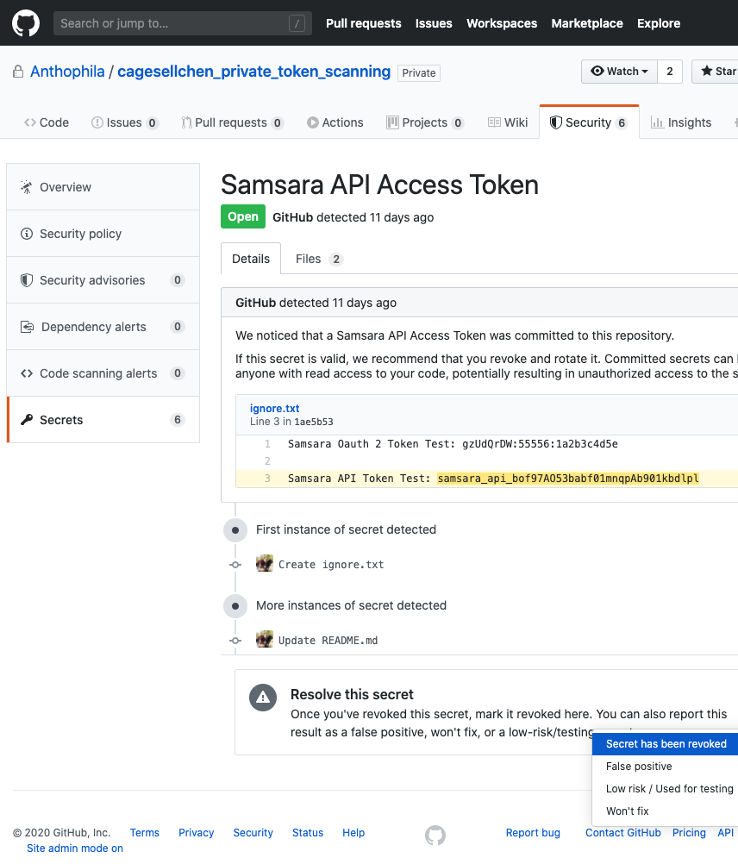
Secret Scanning - GitHub Keeping your secrets, a secret
Identifies secrets as early as possible
Finds secrets the moment they are pushed to GitHub and immediately notifies developers when they are found. Scan your entire git history.
Community of secret scanning partners
For every commit made to your repository, and its full git history, we'll look for secret formats from secret scanning partners
Supports both public and private repos
Secret scanning watches both public and private repos for potential secret vulnerabilities.
Protection from exposed secrets
Automatically disable or suspend secrets from 35+ service providers as soon as they are committed.
https://github.com/features/security
Notes:
NOTE: This is part of the GitHub Advanced Security (GHAS) SKU
Acronyms
SAST = static application security testing
DAST – Dynamic application security testing
IAST – passive and active integrated security testing
RASP – runtime application security protection
SCA – fuzzy software composition analysis
We’re now expanding our coverage to include private repositories for secret scanning. Our capabilities include finding secrets the moment they’re pushed to GitHub, scanning git history and user controls for excluding false positives.
We’re currently supporting more than 25 major service providers including Google Cloud, AWS, Azure, Alibaba Cloud and others. This feature is now available in limited public beta for GitHub Enterprise Cloud.

Slide 15
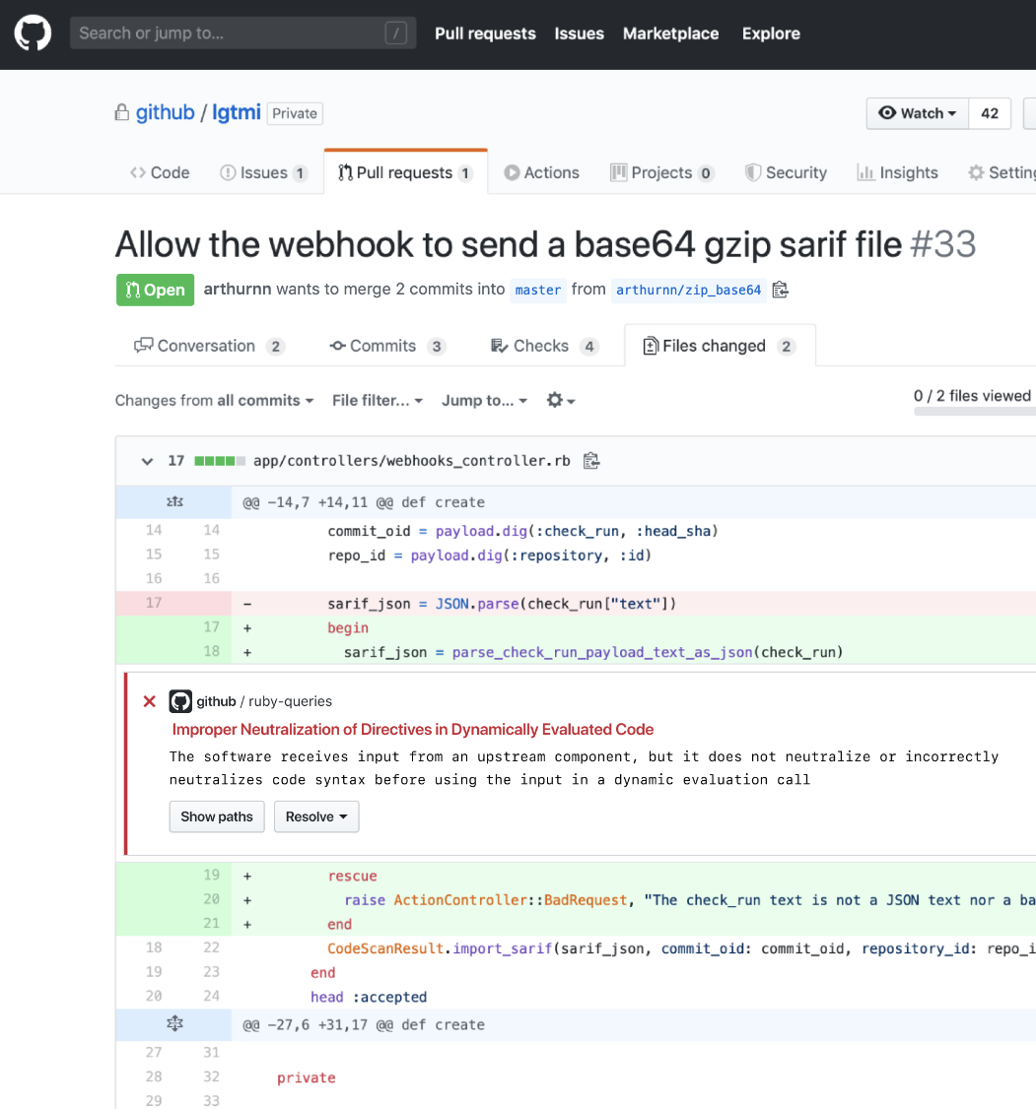
Code Scanning - GitHub Preventing vulnerabilities from the start
Find and fix vulnerabilities fast
Find and fix vulnerabilities before they are merged into the code base with automated CodeQL scans.
Community of top security experts
Community-driven query set powers every project with a world-class security team. Or, create your own custom queries.
Integrated with developer workflow
Integrate security results directly into the developer workflow for a frictionless experience and faster development.
Extensible
Plug other SAST tools into the same developer workflow.
Notes:
NOTE: This is part of the GitHub Advanced Security (GHAS) SKU
Acronyms
SAST = static application security testing
DAST – Dynamic application security testing
IAST – passive and active integrated security testing
RASP – runtime application security protection
SCA – fuzzy software composition analysis
Automated code scanning will provide native security scanning capabilities to the developer workflows.
With these capabilities, our customers will be able to secure code as it’s being developed. New security issues are automatically flagged directly in the pull request where they can be immediately fixed. Security issues are prioritized so that developers can fix the most urgent matters first. Developers and security teams can collaborate on the GitHub platform to triage and fix the issues efficiently.

Slide 16
Code Scanning - Community of top security experts
Code Scanning - Community of top security experts - GitHub Shared security expertise empowers any software organization immediately
Fast and easy to write with extensive libraries. Based on vulnerabilities discovered internally. Often given back to the community where relevant.
Outd
Custom
Community-powered
Created by a vast community of leading security researchers at Microsoft, Google, Uber and others. Regular additions for new classes of vulnerabilities.
Security & Vulnerabilities
CWEs
OWASP Top 10
SANS 25
Language best practices
Correctness
Non-attributable
Readability
Reliability
Statistical
Efficiency
Maintainability
Thousands of analyses created by GitHub’s team of security researchers and language experts, in collaboration with GitHub’s customers.
GitHub-powered
Notes:
2000+ queries out of the box:
You can get value out of the box (clarify this point strongly)
And then you can decide what to do from there
Acronyms
SAST = static application security testing
DAST – Dynamic application security testing
IAST – passive and active integrated security testing
RASP – runtime application security protection
SCA – fuzzy software composition analysis

Slide 17
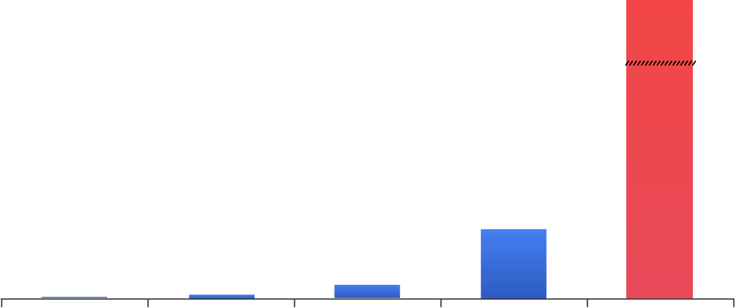
Shift security left
Application flaws: #1 attack vector for breaches
Remediate during development
Lifecycle
Stages
Develop
Build
Test
Deploy
Breach
$ Millions
$7,600
$80
$240
$960
Remediation
Costs
Development
Build
Test/QA
Production
Breach
Sources: NIST, Polemon Institute, Verizon Data Breach Investigations reports 2016, 2017, 2018, 2019 and 2020.
Notes:
A security breach can be tremendously costly
And trying to harden applications after they’re written can be very difficult.
The solution is to shift security development left, addressing security concerns early in the development process. Developers work to fix vulnerabilities when they are found, but they also continue to introduce vulnerabilities into their code bases. So how do we shift security left?
<click>
So for both the code you write and the Open Source code used in your applications
Our aim is to make these security checks a key part of the developer workflow allowing you to identify security issues as soon as possible. Thus, reducing the time, effort and costs associated with keeping your applications secure.

Slide 18
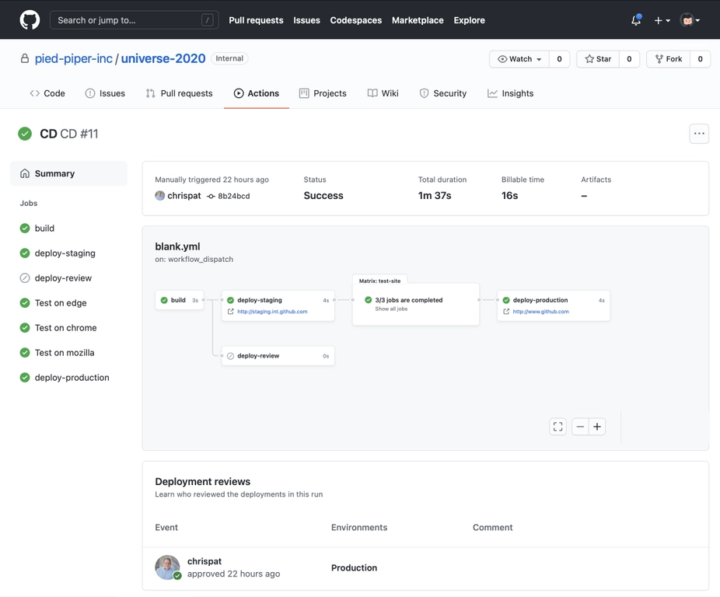
GitHub Automation
Automating workflows from code to cloud
https://github.com/features/actions & New from Universe 2020: Environments, Manual Approvals and Workflow Visualization
Notes:
You can automate a lot more than just CI/CD
https://docs.microsoft.com/en-us/azure/developer/github/
Talking points:
Pull Request automation
Create Issues on the fly based on keywords
Community-powered workflows, more actions than other CI/CD tools

Slide 19
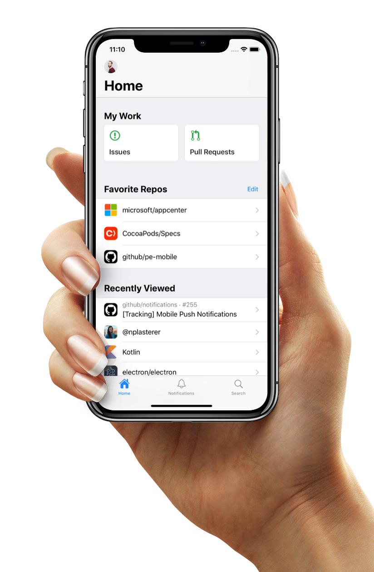
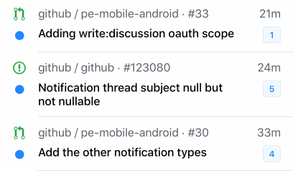
GitHub Mobile
Collaborate and develop, on-the-go
Stay connected
Stay in touch with your team and the GitHub Community, right from your mobile device
Collaborate from anywhere
Collaborate on Issues and Pull Requests with a totally redesigned experience. Comment, react, and merge code.
Breeze through your workflow
Get your inbox to zero in no time—swipe to finish a task or save the notification to return to it later.
https://github.com/mobile/
Notes:
Quickly access your issues and pull requests dashboard on the go.
Ensure secure access by leveraging multi-factor authentication
Search GitHub for Users, Repos, Orgs, Issues, and Pull Requests. Browse results with mobile-optimized designs.
Collaborate on Issues and Pull Requests with a totally redesigned experience. Comment, react, and merge code.
“Favorite Repos” and “Recently Viewed” sections
With GitHub mobile, you can:
Organize tasks in a swipe: Get your inbox to zero in no time—swipe to finish a task or save the notification to return to it later.
Give feedback and respond to issues: Respond to comments while you’re on the go.
Review and merge pull requests: Merge and mark pull requests to breeze through your workflow, wherever you are.

Slide 20
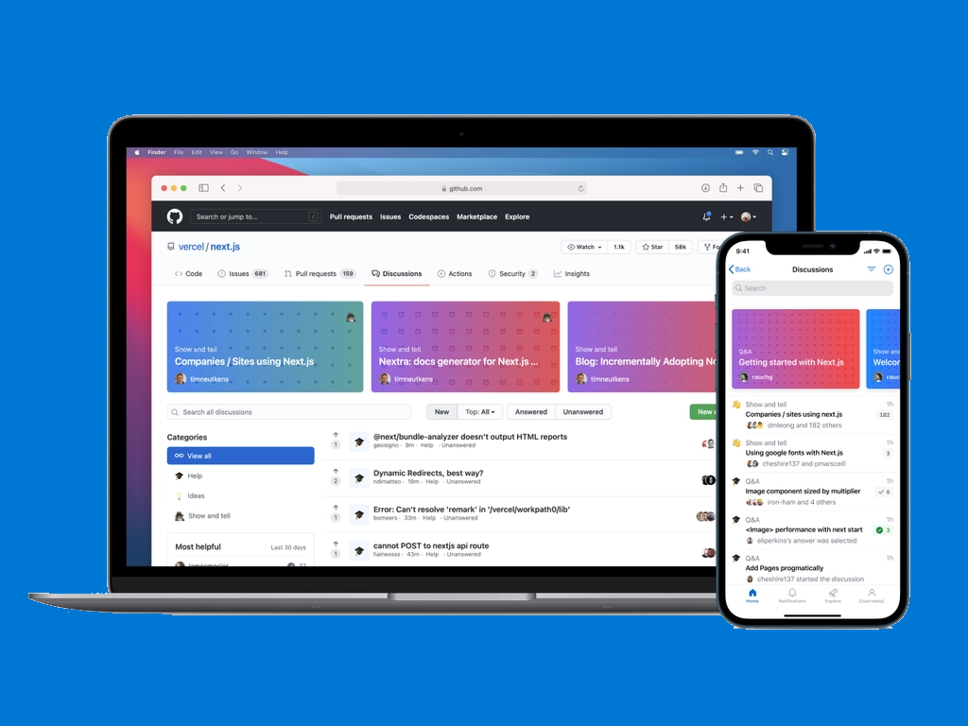
Discussions
Join the conversation
Open conversations about code and community
New threaded format makes it easy to brainstorm feature ideas, help new users get their bearings, and collaborate on software.
Perfect for Q&A
Questions can be marked as answered, so over time a community’s knowledge base grows naturally
Familiar GitHub experience
Discussions live in your project repository, so they’re accessible where your community is already working together.
https://docs.github.com/en/discussions
Notes:
Software communities don’t just write code together. They brainstorm feature ideas, help new users get their bearings, and collaborate on best ways to use the software. Until now, GitHub only offered issues and pull requests as places to have these conversations. But issues and pull requests both have a linear format—well suited for merging code, but not for creating a community knowledge base. Conversations need their own place—that’s what GitHub Discussions is for.
Discussions live in your project repository, so they’re accessible where your community is already working together. Their threaded format makes it easy to start, respond to, and organize unstructured conversations. Questions can be marked as answered, so over time a community’s knowledge base grows naturally. And because discussions aren’t closed the way issues are, they can easily serve as a place for maintaining FAQs and other collaborative documentation. We recognize that community discussion is as much a part of development as coding, so discussion contributions appear in users’ contribution graphs.
Talking points:
New/Requested Features Discussions
Issues with a particular feature

Slide 21

Other features

Slide 22
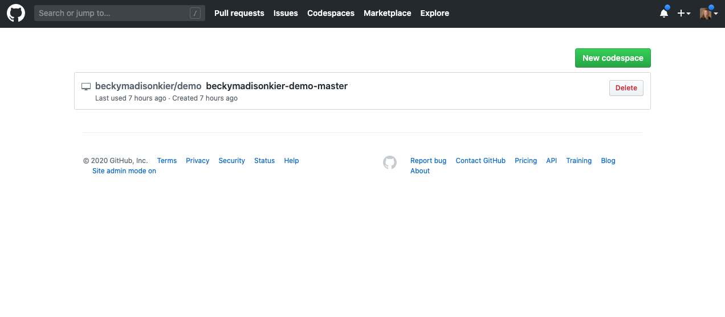
GitHub Codespaces
Your instant dev environment
https://github.com/Features/Codespaces
Notes:
Reducing time to set up development environments from hours to seconds
Powered by web-based version of VS Code, or use with your desktop IDE
Fully integrated into the GitHub developer experience
Talking points
Code on Any device
Instant Productivity

Slide 23
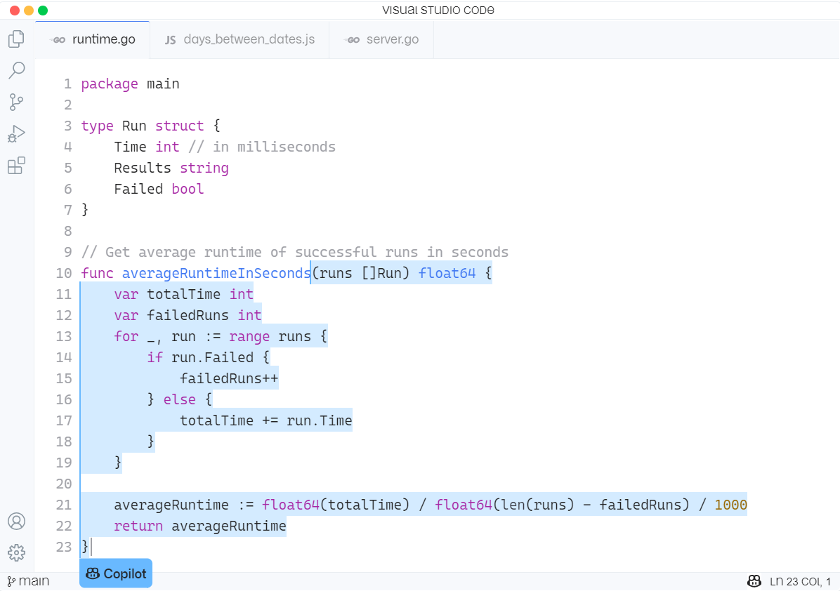
GitHub Copilot
Your AI pair programmer
Introducing GitHub Copilot: your AI pair programmer
Notes:
With GitHub Copilot, get suggestions for whole lines or entire functions right inside your editor.
Trained on billions of lines of public code, GitHub Copilot puts the knowledge you need at your fingertips, saving you time and helping you stay focused.
GitHub Copilot is powered by Codex, the new AI system created by OpenAI (gpt3). GitHub Copilot understands significantly more context than most code assistants.
As developers, we know that everything has been written before, right?
Talking points:
---------------
Not Just Intelli-sense or auto complete.
Great for repetitive tasks like unit tests, unfamiliar territories like new languages or writing code that has been written before within the same context (Language/scope)

Slide 24
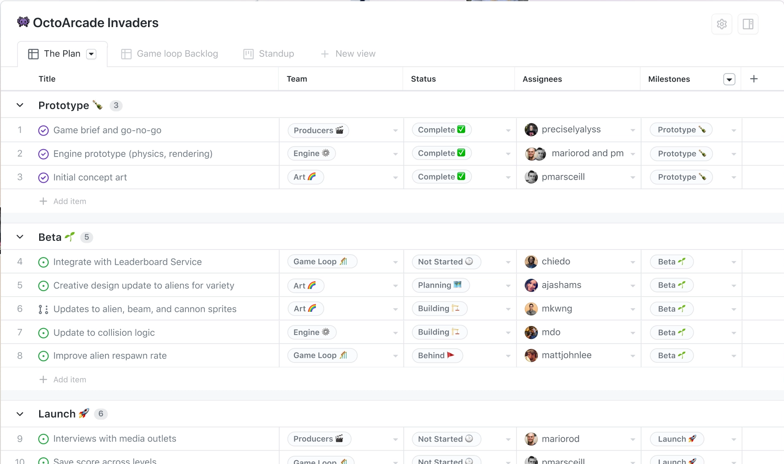
Planning
Introducing the new GitHub Projects
Introducing the new GitHub Issues | The GitHub Blog
Notes:
Talking points:
Better Project management capabilities with project tables -- more than just kanban style boards
Break issues into actionable tasks: Tackle complex issues with task lists and track their status with new progress indicators. Convert tasks into their own issues and navigate your work hierarchy.
Custom Views: build multiple tabs with custom filters, groups …
Extend issues with custom fields: Track metadata like priority, story points, dates, notes, and links. Add custom fields to project tables and edit from the issue sidebar.
Issues, wherever you look: Issues can be viewed, created, and managed in your browser, your favorite terminal, or on your phone or iPad.

Slide 25
What Does this Mean for Azure DevOps?
Microsoft is fully committed to Azure DevOps
Strategic investments in GitHub
Our commitments to you
Integration between GitHub Enterprise and Azure DevOps services
Integration between GitHub and Azure
Make it easier to acquire both products together
Comprehensive set of tools to move to GitHub
MICROSOFT CONFIDENTIAL – SHARED UNDER NDA
Notes:
Azure DevOps is NOT Dead
We are not deprecating or sunsetting Azure DevOps.
Remain fully committed to Azure DevOps customers. We will continue to support and invest in Azure DevOps in the long term. We will prioritize the needs of enterprise customers with a focus on scale, security, compliance, administration, and GitHub integrations.

Slide 26
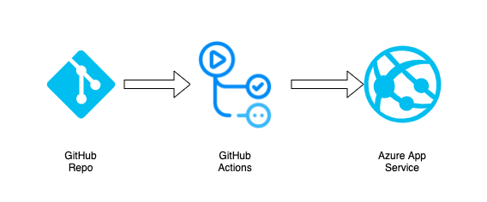
Lab time

Slide 27



DevOps Lab
GitHub Repo
GitHub Actions
Azure App Service
aka.ms/azuredevdaylabs/devops
Azure Dev Day

Slide 28
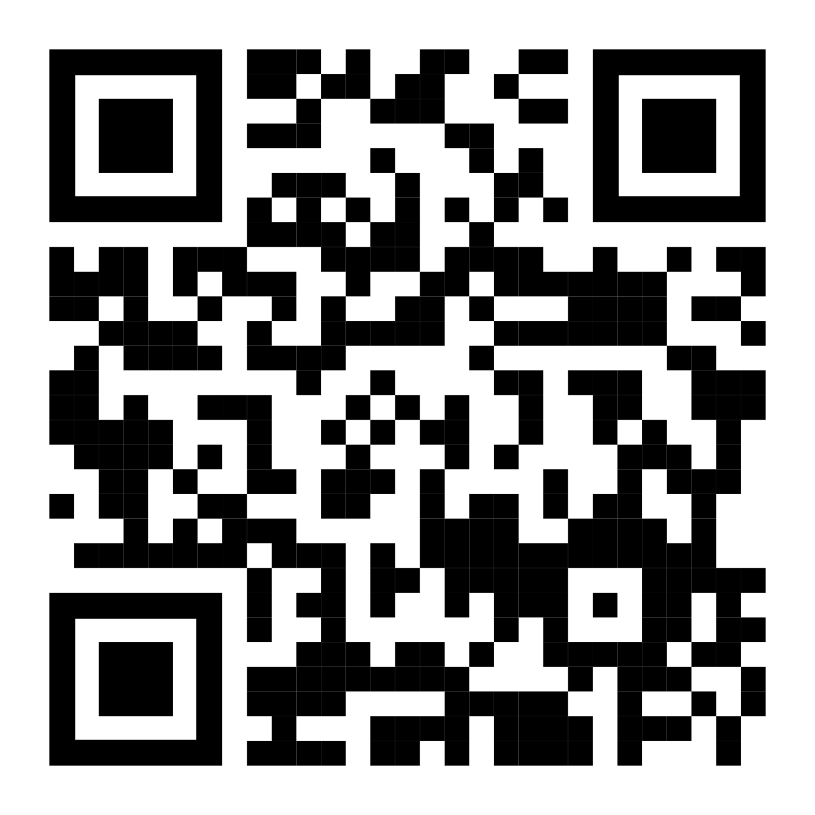
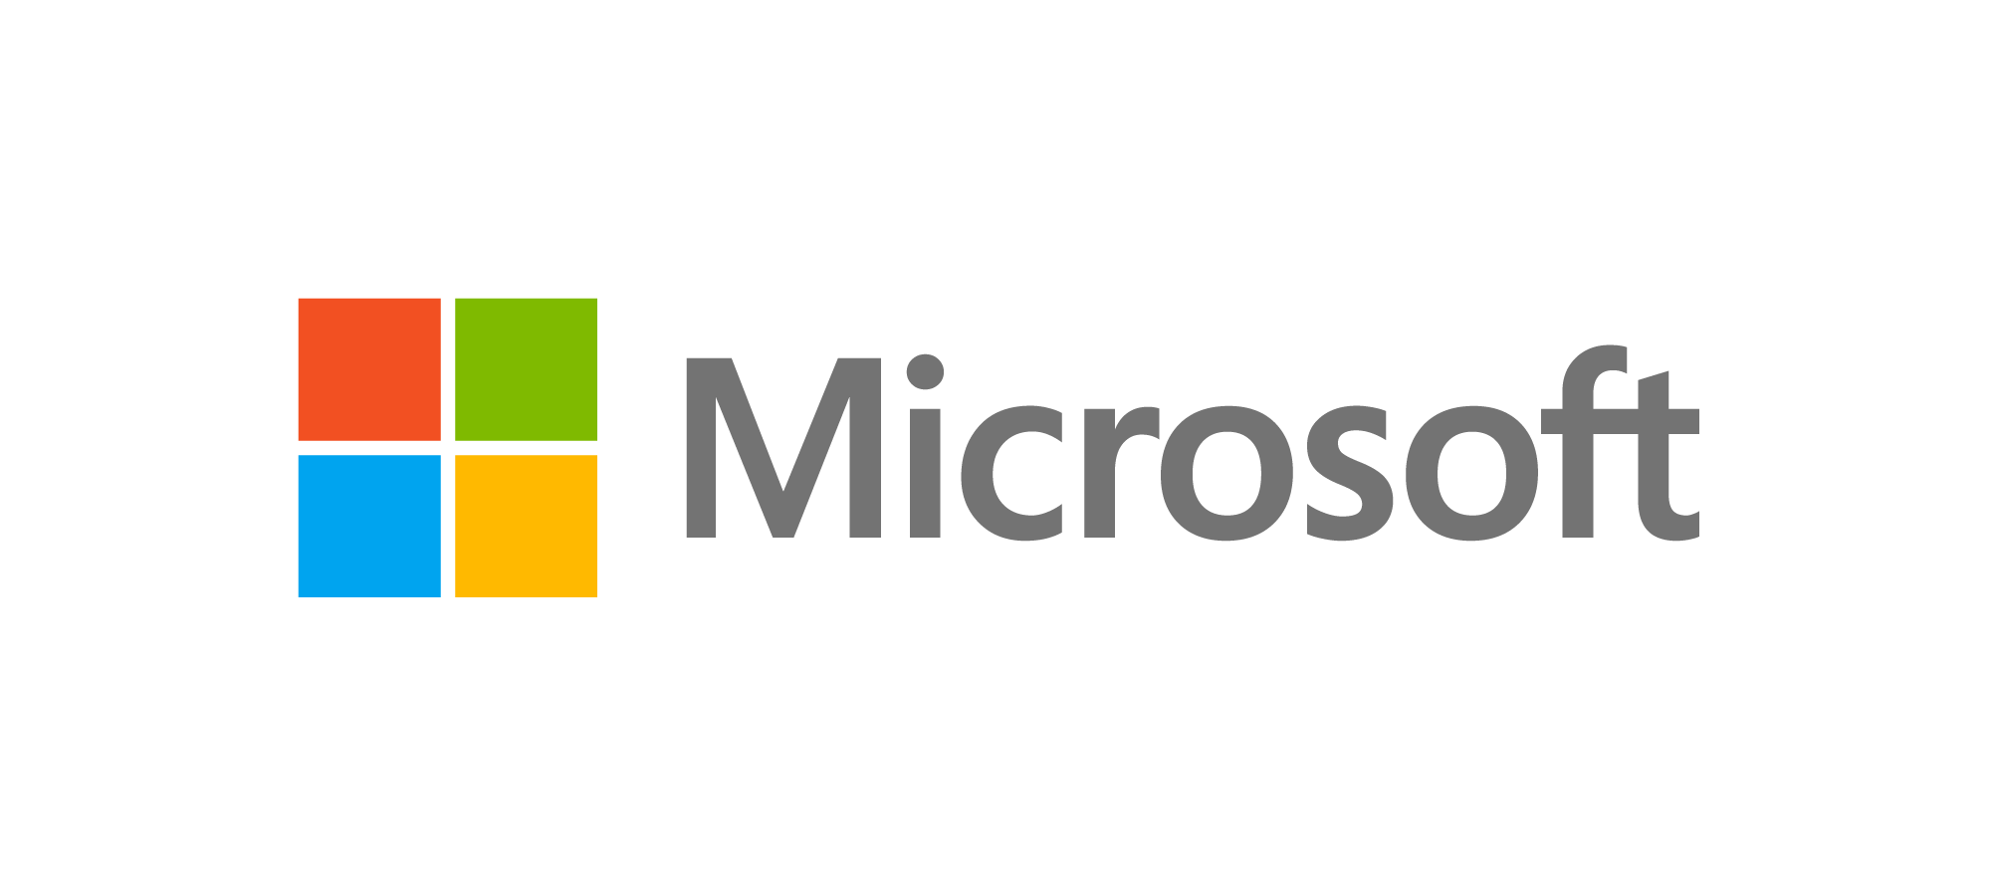
Sign up for Microsoft.Source
Thank you!
Receive a regular digest of relevant technical content, events and training
Get the best of the newest resources, tools and guidance to help developers quickly build and deploy on Azure
Please fill out the Azure Dev Day Survey!
aka.ms/azuredevdaysurvey
And visit our event content page to access lab materials, presentations and more about the Microsoft Build Conference!
aka.ms/azuredevdaycontent
Get the latest articles, documentation, and events from Microsoft.Source—the curated monthly developer community newsletter.
Stay at the forefront of rapidly evolving technologies with resources that are relevant to your field, location, and areas of interest—including articles, GitHub repositories, and how-to guides.
Get notified about events—from local hacks, workshops, and training sessions to virtual meetups and global conferences.
Learn what you want, when you want, how you want. Resources include in-person hands-on workshops, free, interactive online training and sandbox environments.

Slide 29
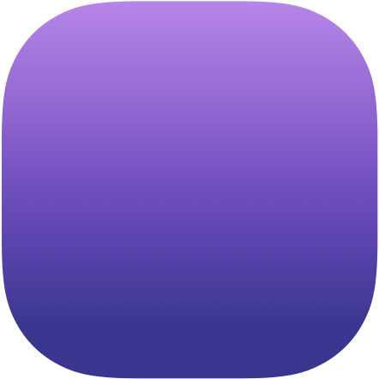



GitHub Enterprise Foundation
Coming Soon!
GitHub Enterprise Server
GitHub AE
GitHub Enterprise Cloud
Self-managed & Flexible
Reliable and scalable solution packaged for self-managed deployments. Provides maximum flexibility and ease of operations.
Secure & Fully Managed
For the most demanding deployments in regulated industries and government agencies. Cloud control plane, single tenant. FedRAMP certified.
Convenient & Reliable
Maximum convenience for fast growing enterprises. Multi-tenant, highly available service with 99.95% uptime.
Notes:
GitHub AE is a security-enhanced and compliant way to use GitHub in the cloud.
GitHub AE enables you to move your DevOps workload to the cloud while meeting stringent security and compliance requirements. GitHub AE is fully managed, reliable, and scalable, allowing you to accelerate delivery without sacrificing risk management.
We have deployment options for everyone, including enterprise server for full control and flexibility to enterprise cloud for convenience and simplicity. We also have private cloud for customers wanting the convenience of the cloud but want the control afforded in a single-tenant model.
GHAE:
Our most advanced security controls
Fully managed, single-tenant deployment
Data sovereignty for any location – tell us which Azure region for us to deploy to
We manage the infra, upgrades, and all that
Options for on-prem and hybrid deployments
GitHub AE is currently under limited release. Please contact our Sales Team to find out more.
See the Satellite Blog Post: https://github.blog/2020-05-06-new-from-satellite-2020-github-codespaces-github-discussions-securing-code-in-private-repositories-and-more/#private
What does AE stand for? It stands for Aegis. Aegis implies protection and security - attributes that are totally core to the product.
Aegis means the protection, backing, or support of a particular person or organization. In Greek mythology aegis is an attribute of Zeus or Athena, usually represented as a shield.

Slide 30

GitHub AE
Fully managed, single-tenant cloud service
Bring-your-own-key encryption, work accounts, data sovereignty
High availability and disaster recovery, durable backups
Available in multiple Azure regions
Azure Active Directory (AAD) integration & ExpressRoute support
Coming Soon
Notes:
[Private Instances will be the most secure and compliant developer cloud – with things like bring-your-own-key encryption, and FedRAMP compliance.
And you’ll be able to run Private Instances – fully managed – in an Azure datacenter, and be able to use features like AAD Access Control and ExpressRoute with it.
We’re excited about Private Instances, and as of a couple of weeks ago, we now have our first customer – we have an instance up and running for teams at Microsoft. So lock for more there soon.

Slide 31
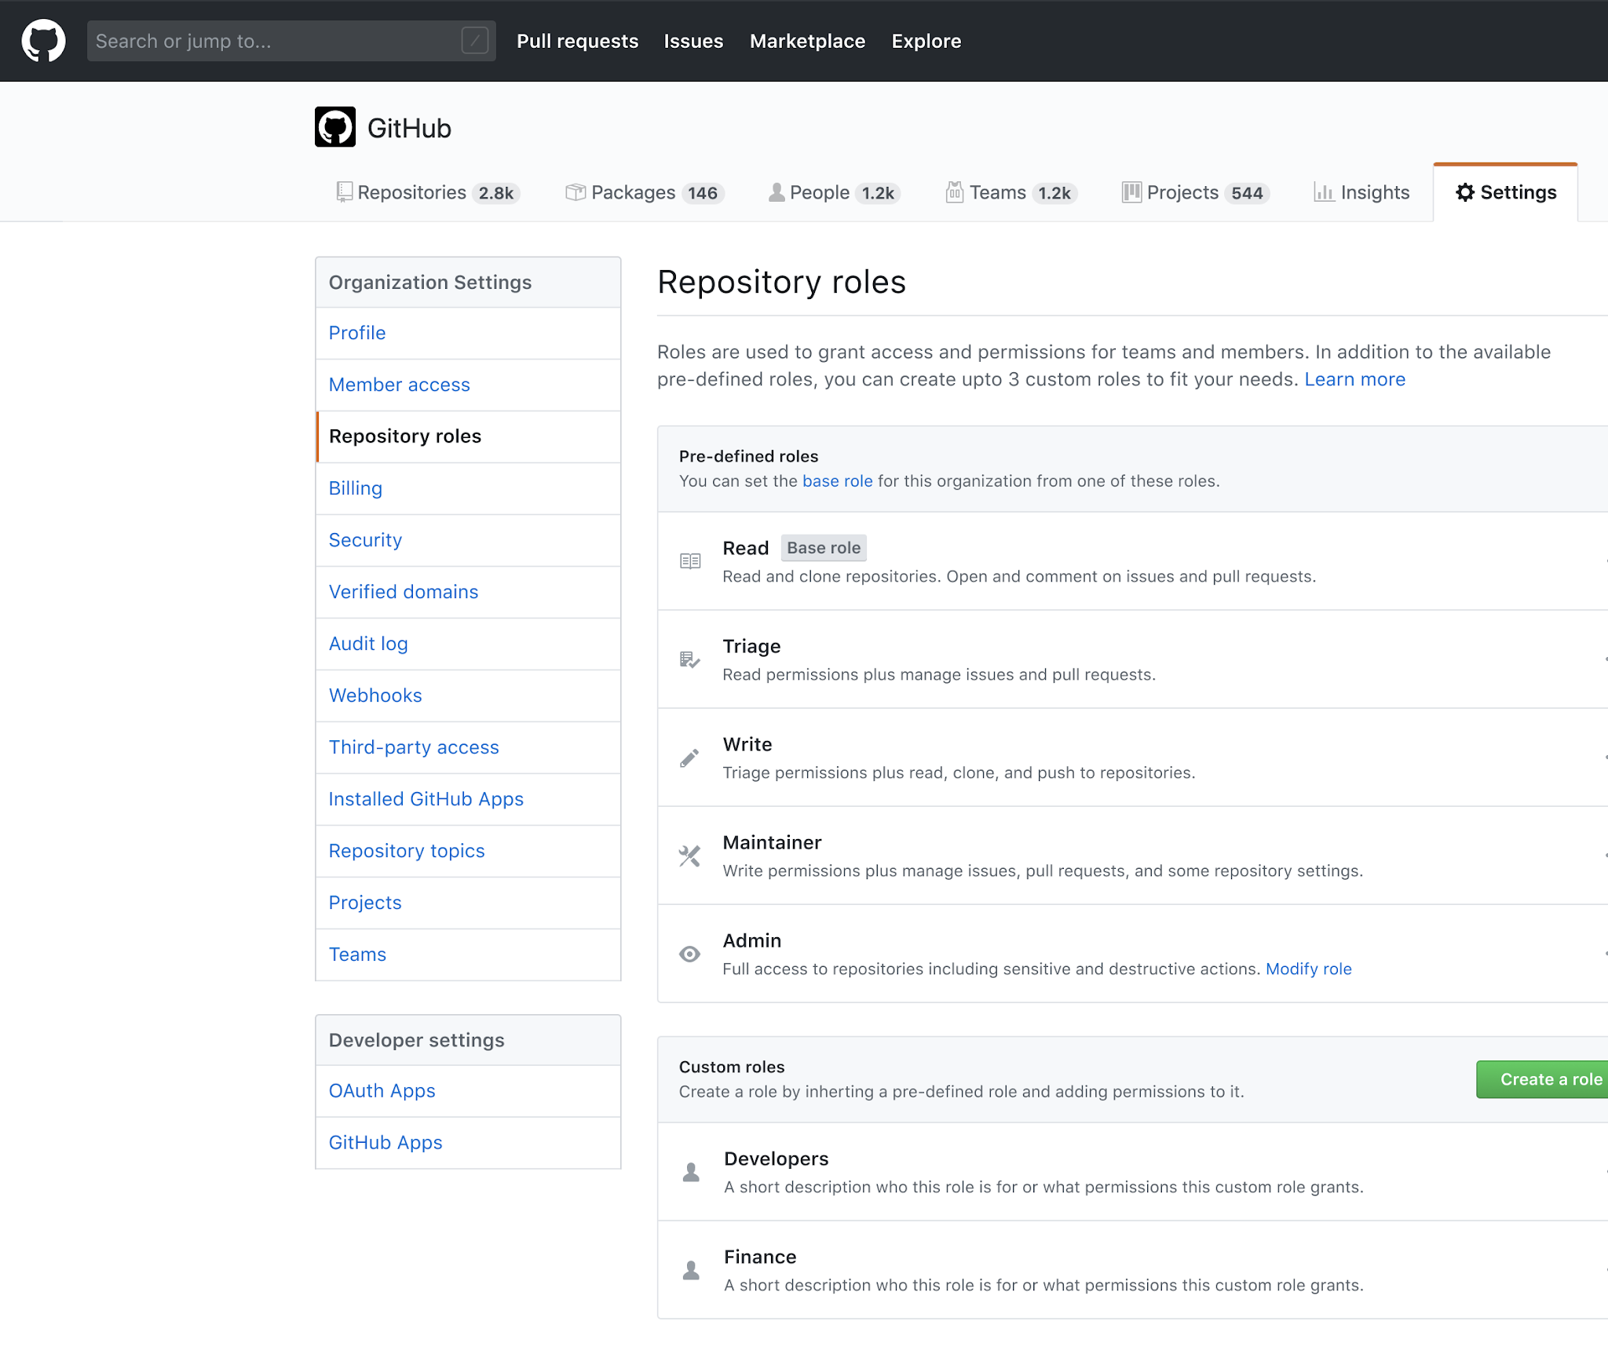
GitHub Enterprise Active Directory support
Available today
Azure Active Directory (AAD) sign-on and Team Sync, GitHub auth
Work accounts—AAD as your primary ID
Finer-grained permissions and custom roles
Service accounts and security groups
Coming soon
Enterprise Managed Users (Private Beta) · Issue #132 · github/roadmap
Notes:
[shanku] Last year, we did a bunch of work to integrate the products together, and we also added better account support – the ability to use Team Sync to synchronize your AAD teams with GitHub, and the ability to use GitHub auth in Azure.
Today you still have to first create a GH account and tie it to an Azure AD account
Enterprise Managed Users, in private beta today, you can only create GH accounts based on Azure AD accounts.
This year, we’re going to do more. Later this year, we’ll launch work accounts, which will let you just use AAD as the source of users on your account, instead of needing GitHub accounts. We’re also going to add more custom roles to GitHub, and introduce finer-grained permissions that can may to AAD. And we’ll support service accounts and security groups as well.
But a lot of customers tell us need higher security and compliance, and they want the ability to run GitHub in Azure. So, later this year, we’re launching…

Slide 32

Choose the Best Tool for each Phase of DevOps
Notes:
What about today? What tools we should use today?

Slide 33
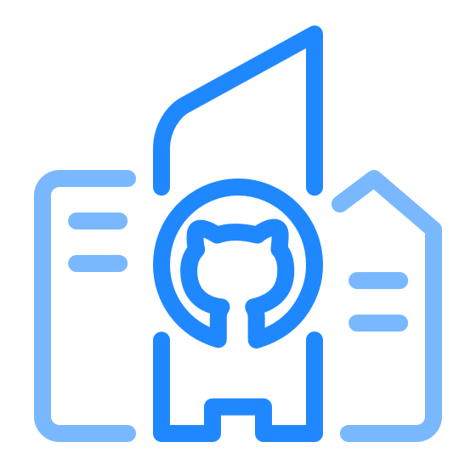
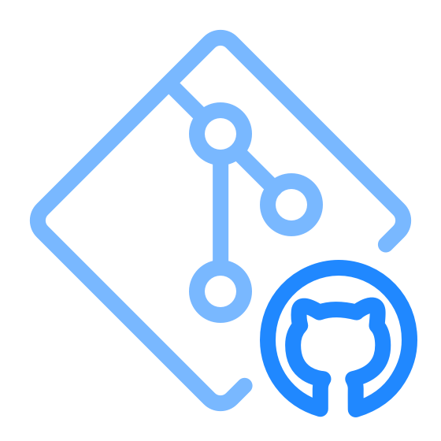

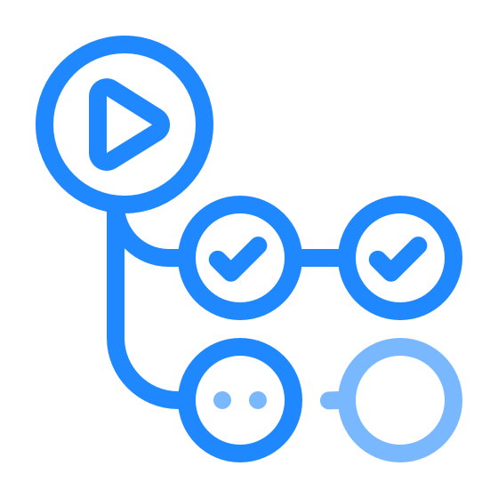
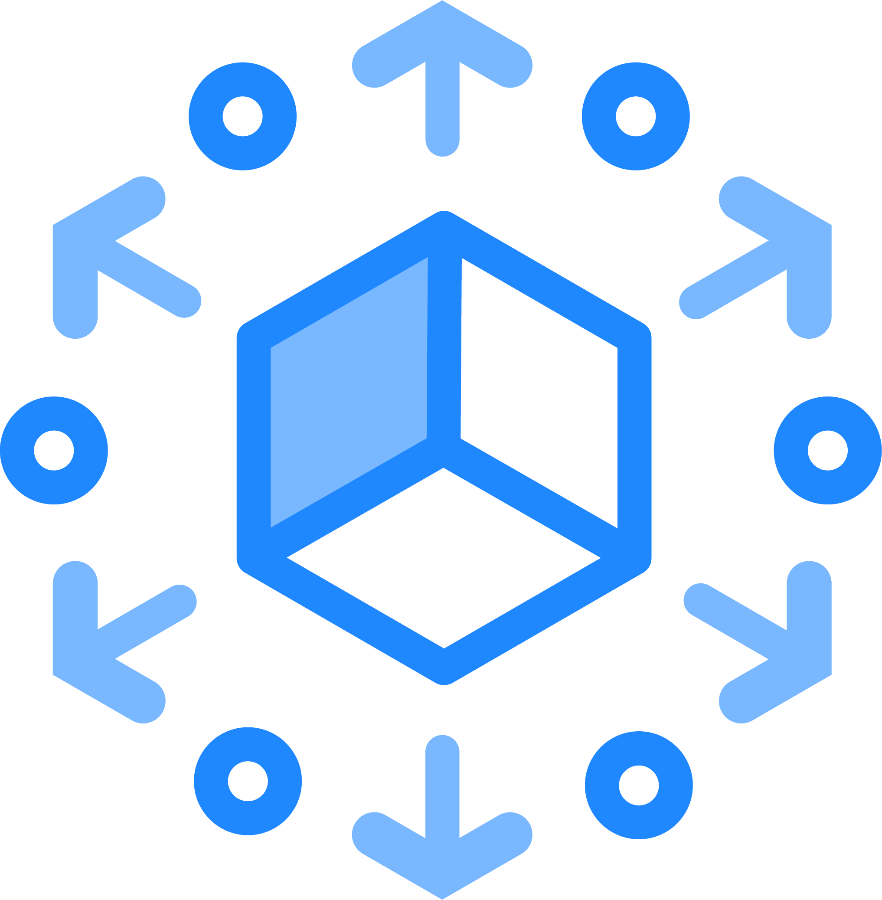


Adopting GitHub
Leverage your Existing Azure DevOps Investment while
Move Repositories to GitHub
Keep your builds and/or boards in Azure DevOps
Automate non-build workflows with GitHub Actions
Use GitHub Package Registry & Azure Artifacts
Decision maker’s guide can be shared under NDA
Notes:
For Git Repository GitHub is the place with wide ecosystem, Better Security features and familiar look experience. If you want to use TFVC, ADO is the place.
For Project Management and Agile Tools Use Azure Boards (Azure DevOps) Up to a couple of years before GH has parity with ADO Boards
For CI/CD Pipelines, If you already have an investment in Azure Pipelines, continue to use them. GH Actions is great to use though. And can provide better automations. For new projects, take a look at GH workflows & actions
For Managing And Storing Packages and Artifacts, use GitHub Registry or Azure Artifacts. Both are great.
Keep in mind both GitHub and ADO has seamless cross support for each others' services. You can mix & match these services just fine.
We are building migration tooling at every level so you can have peace of mind

Slide 34

Demo: GitHub with Azure
Notes:
https://dev.azure.com/sepakbaz/PartsUnlimited
Demo Dashboard, Wiki, Agile tools (Scrum Template)
https://github.com/pakbaz/PartsUnlimited
GitHub Demo:
https://github.com/features/issues/

Slide 35
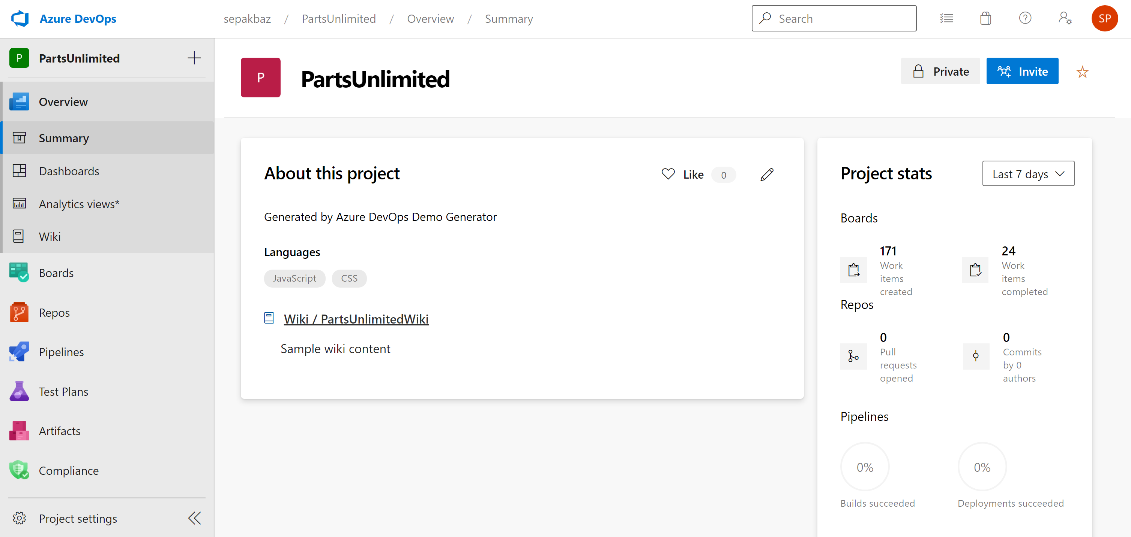
Notes:
https://dev.azure.com/sepakbaz/PartsUnlimited
Demo Dashboard, Wiki, Agile tools (Scrum Template)
https://github.com/pakbaz/PartsUnlimited
GitHub Demo:
https://github.com/features/issues/

Slide 36
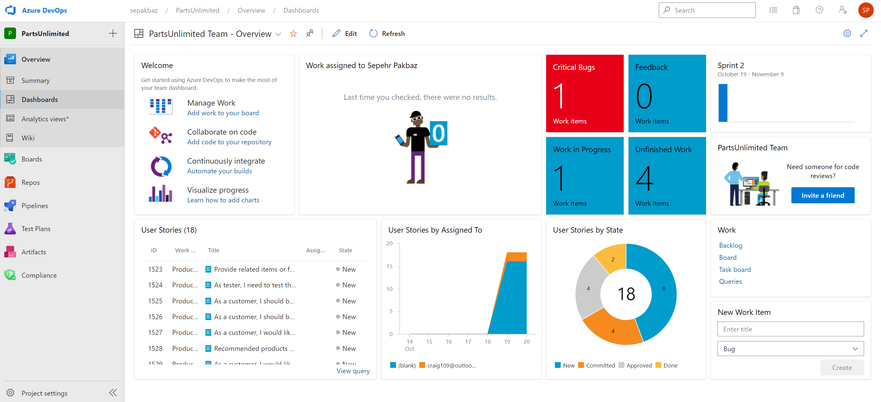
Notes:
https://dev.azure.com/sepakbaz/PartsUnlimited
Demo Dashboard, Wiki, Agile tools (Scrum Template)
https://github.com/pakbaz/PartsUnlimited
GitHub Demo:
https://github.com/features/issues/

Slide 37
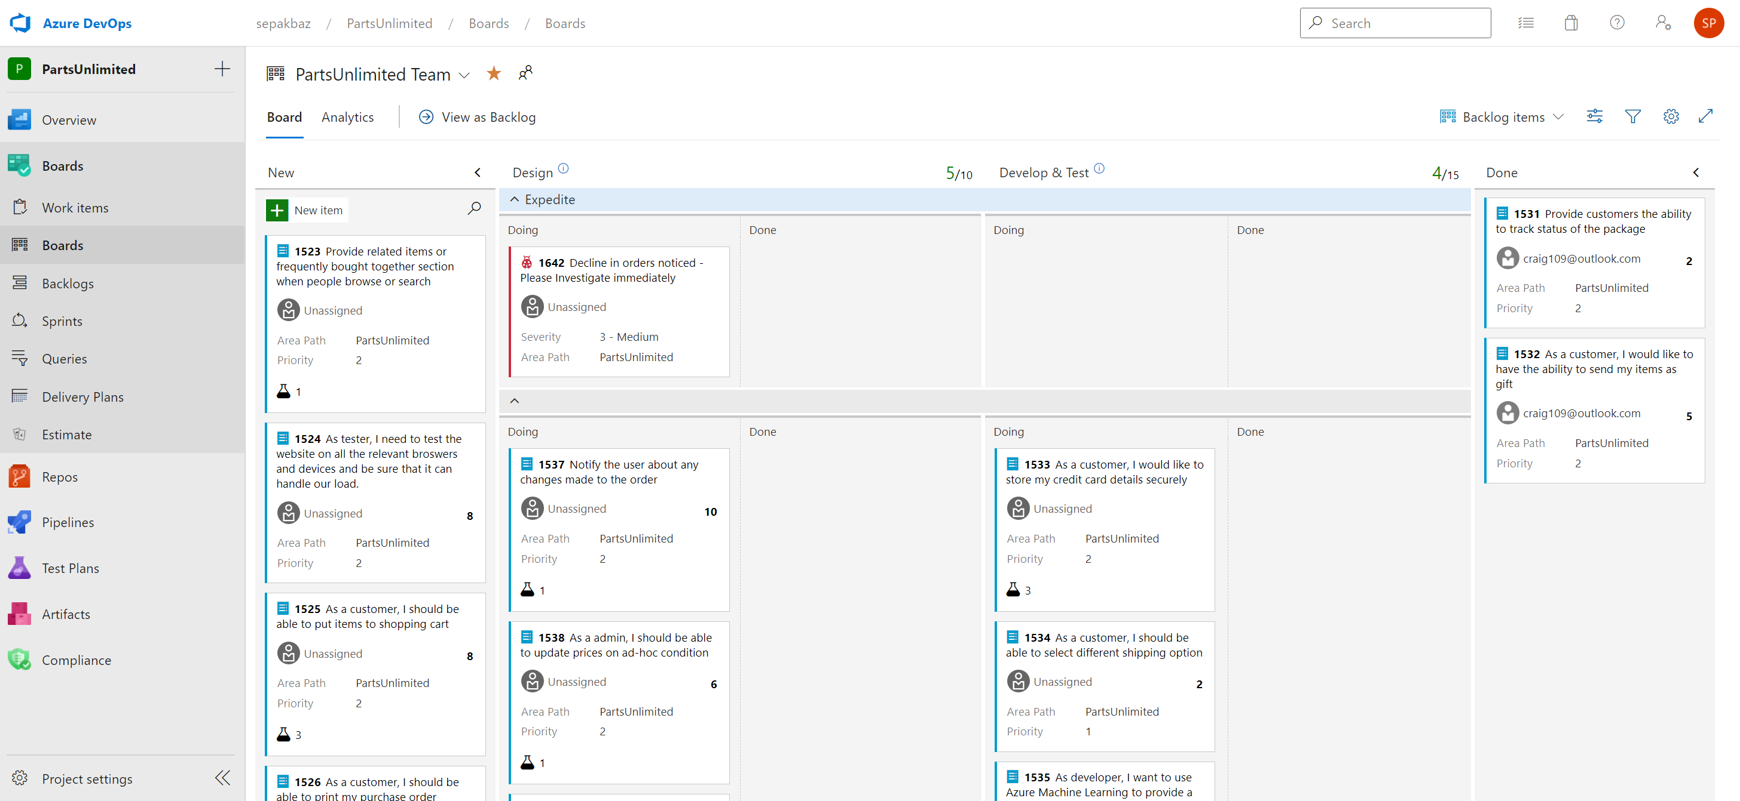
Notes:
https://dev.azure.com/sepakbaz/PartsUnlimited
Demo Dashboard, Wiki, Agile tools (Scrum Template)
https://github.com/pakbaz/PartsUnlimited
GitHub Demo:
https://github.com/features/issues/

Slide 38
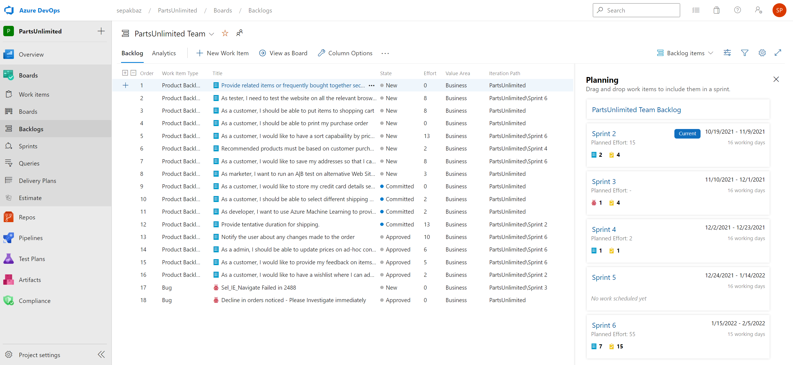
Notes:
https://dev.azure.com/sepakbaz/PartsUnlimited
Demo Dashboard, Wiki, Agile tools (Scrum Template)
https://github.com/pakbaz/PartsUnlimited
GitHub Demo:
https://github.com/features/issues/

Slide 39
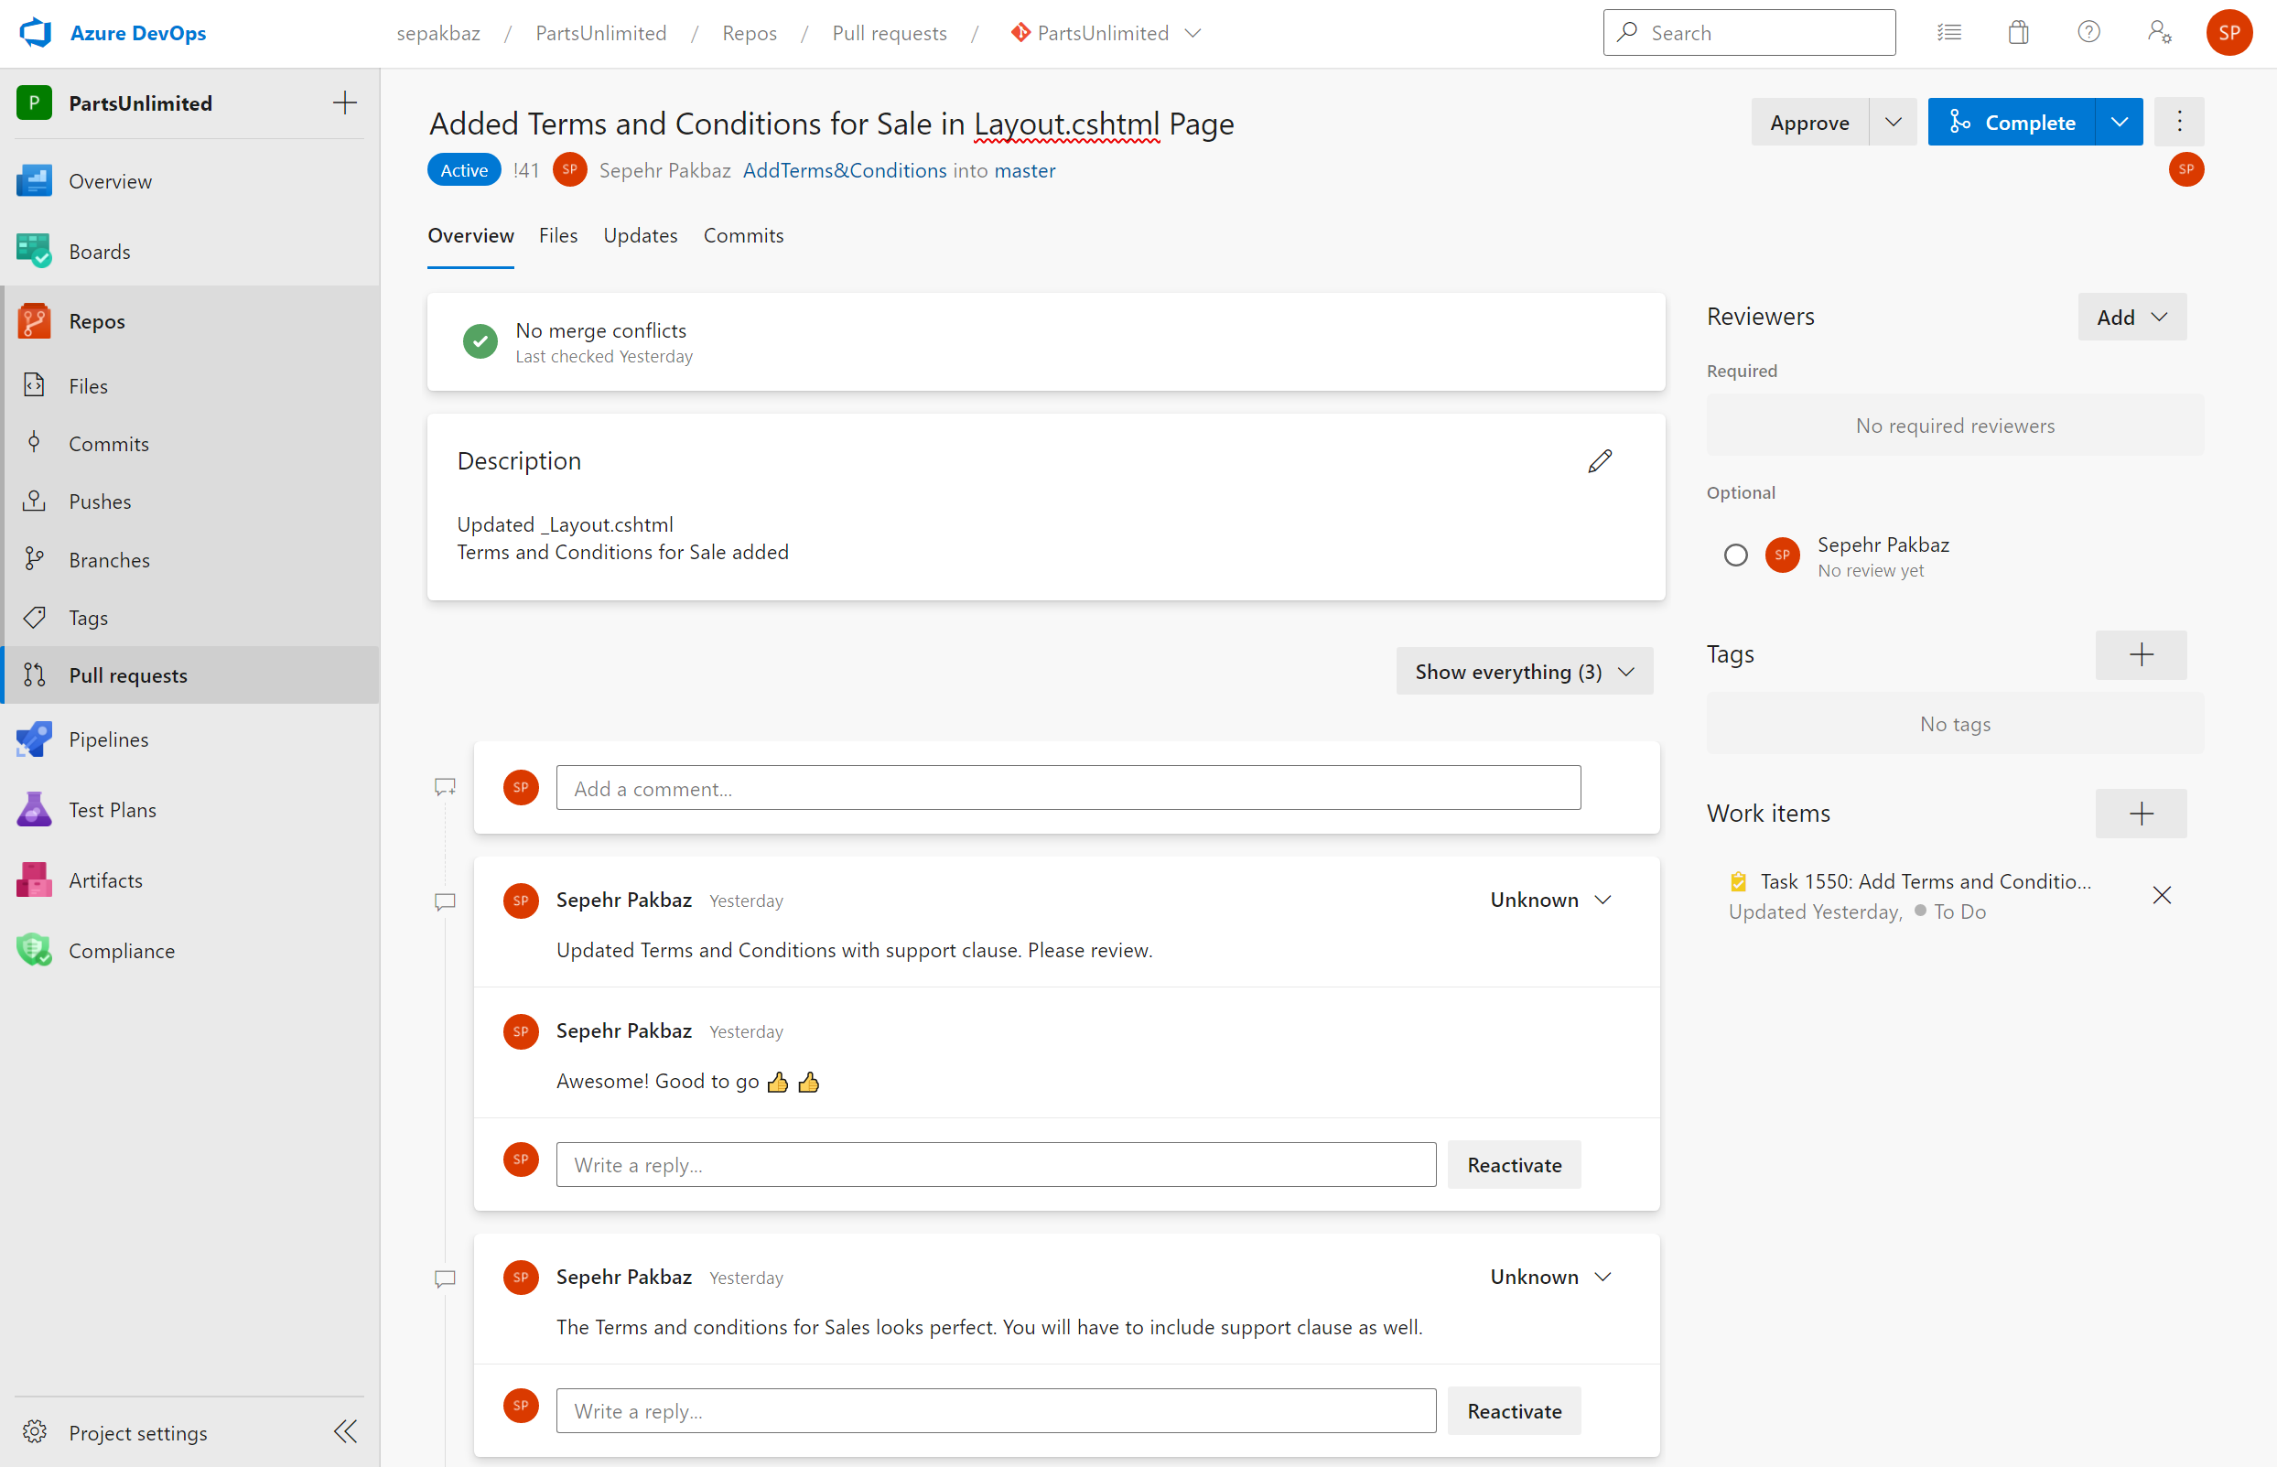
Notes:
https://dev.azure.com/sepakbaz/PartsUnlimited
Demo Dashboard, Wiki, Agile tools (Scrum Template)
https://github.com/pakbaz/PartsUnlimited
GitHub Demo:
https://github.com/features/issues/

Slide 40
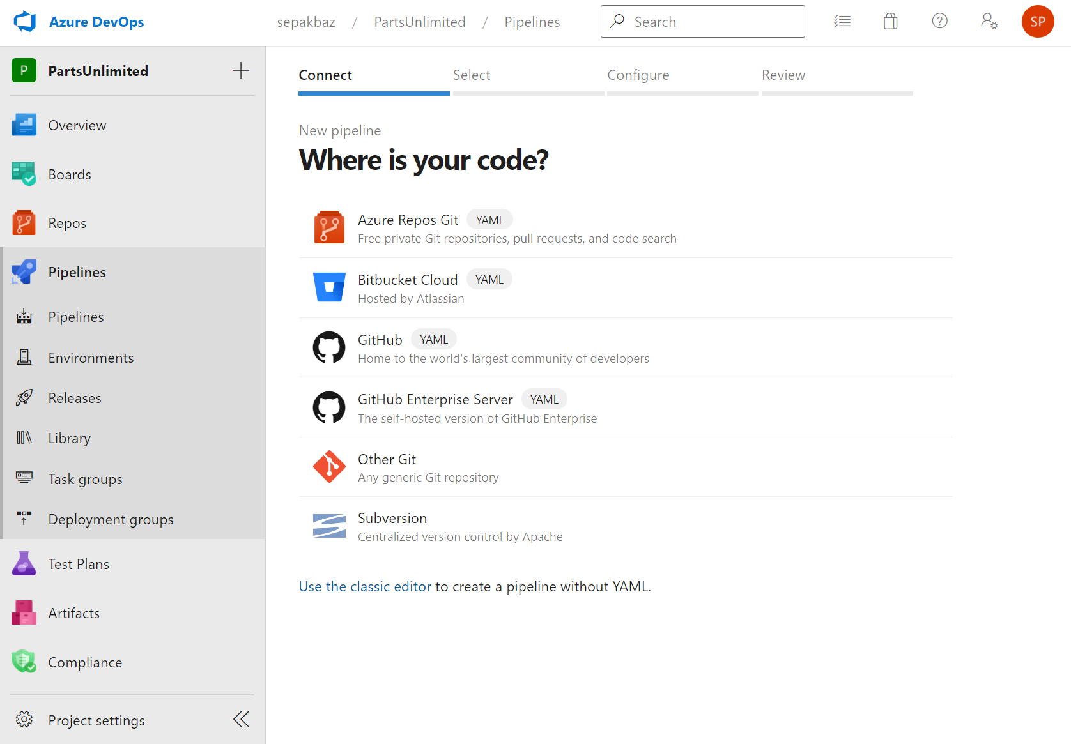
Notes:
https://dev.azure.com/sepakbaz/PartsUnlimited
Demo Dashboard, Wiki, Agile tools (Scrum Template)
https://github.com/pakbaz/PartsUnlimited
GitHub Demo:
https://github.com/features/issues/

Slide 41
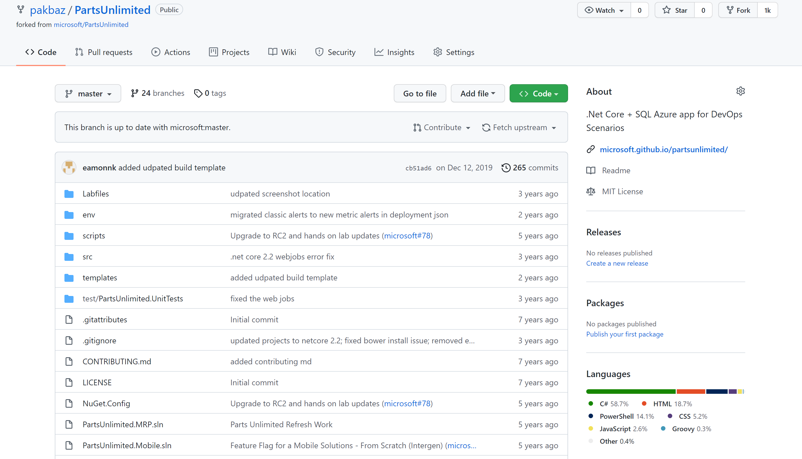
Notes:
https://dev.azure.com/sepakbaz/PartsUnlimited
Demo Dashboard, Wiki, Agile tools (Scrum Template)
https://github.com/pakbaz/PartsUnlimited
GitHub Demo:
https://github.com/features/issues/

Slide 42
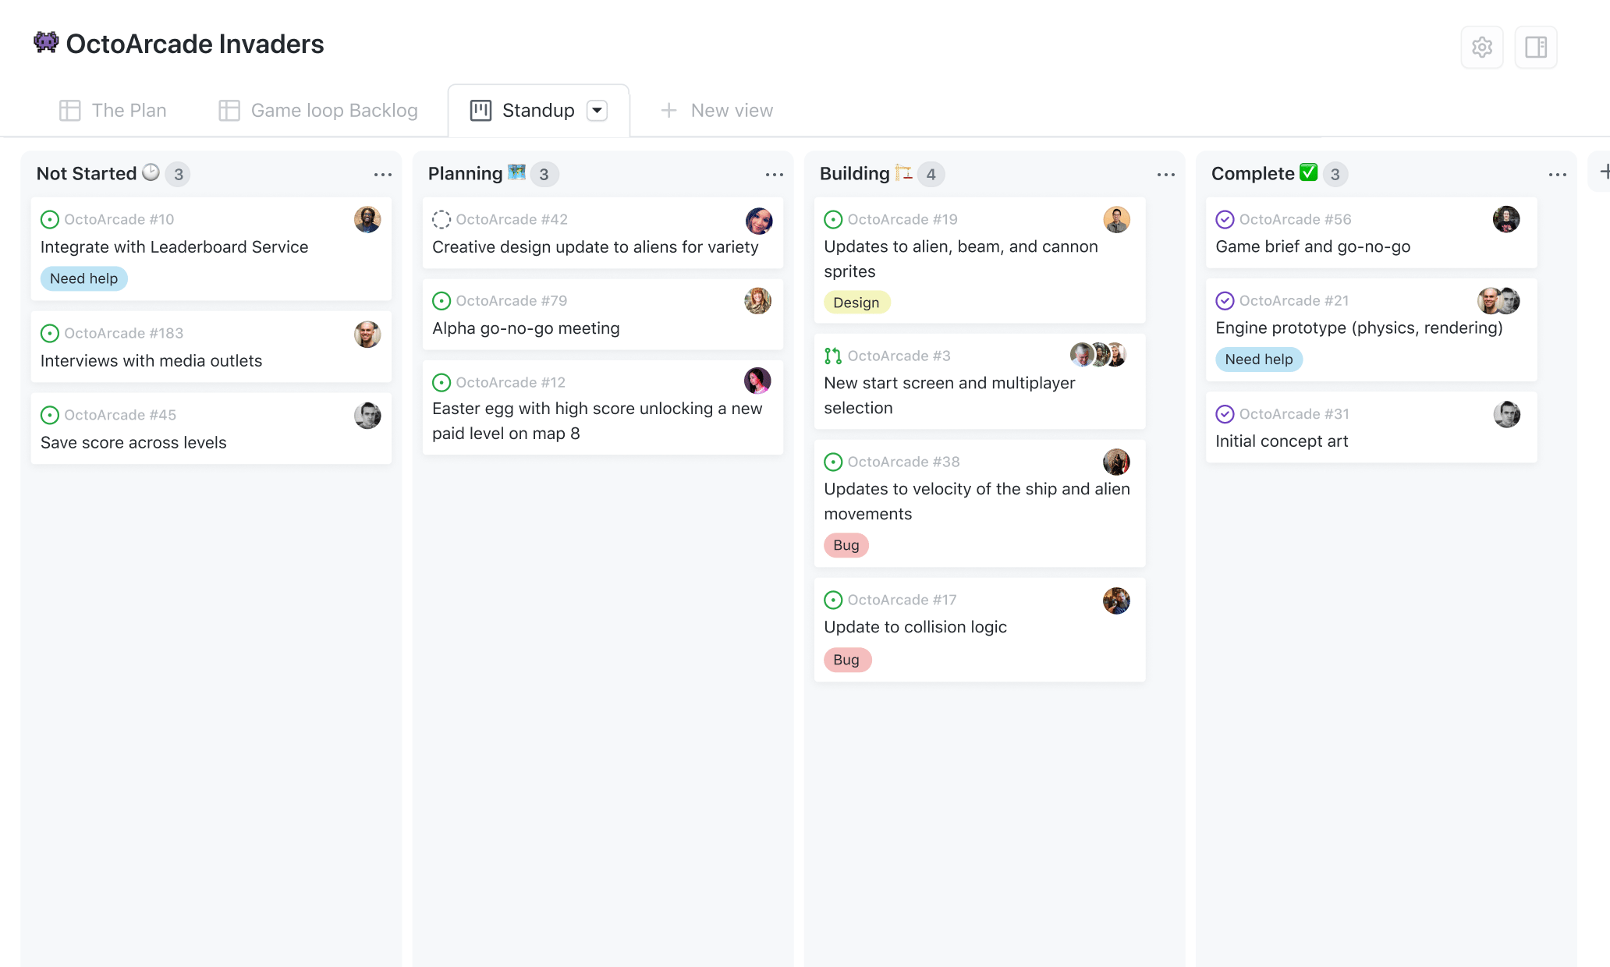
Notes:
https://dev.azure.com/sepakbaz/PartsUnlimited
Demo Dashboard, Wiki, Agile tools (Scrum Template)
https://github.com/pakbaz/PartsUnlimited
GitHub Demo:
https://github.com/features/issues/

Slide 43
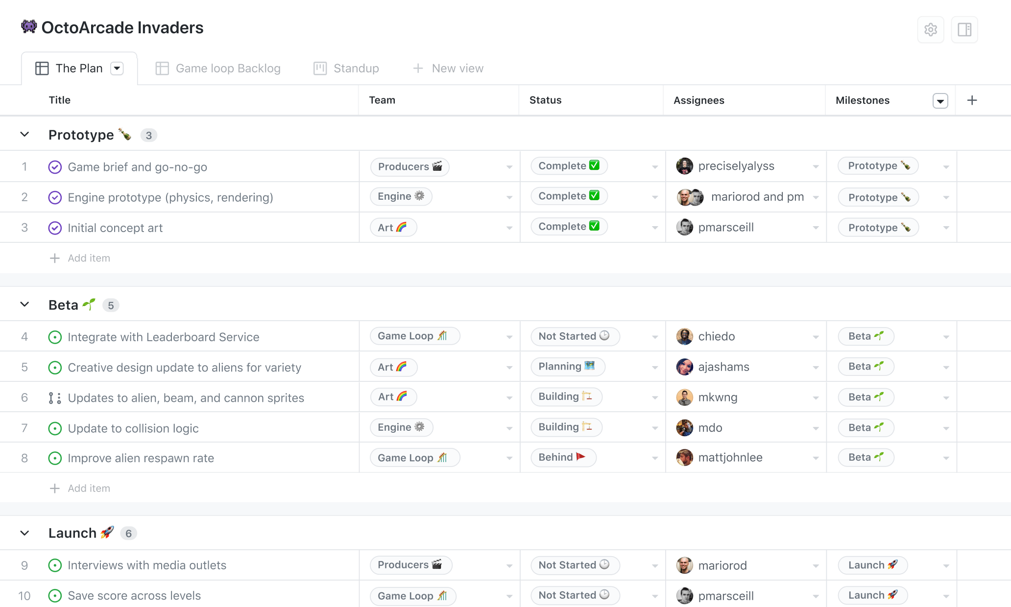
Notes:
https://dev.azure.com/sepakbaz/PartsUnlimited
Demo Dashboard, Wiki, Agile tools (Scrum Template)
https://github.com/pakbaz/PartsUnlimited
GitHub Demo:
https://github.com/features/issues/

Slide 44

Project planning for developers
Create issues, break them into tasks, track relationships, add custom fields, and have conversations. Visualize large projects as spreadsheets or boards and automate everything with code.
Break issues into actionable tasks
Tackle complex issues with task lists and track their status with new progress indicators. Convert tasks into their own issues and navigate your work hierarchy.
Notes:
https://dev.azure.com/sepakbaz/PartsUnlimited
Demo Dashboard, Wiki, Agile tools (Scrum Template)
https://github.com/pakbaz/PartsUnlimited
GitHub Demo:
https://github.com/features/issues/

Slide 45

Follow the GitHub and Azure DevOps Roadmaps

Slide 46
Presenter guidance – Product Roadmaps
Title | Choose the Best Tool for each Phase of DevOps
Main Objective | Follow the GitHub and Azure DevOps Roadmaps
Usage Guidance | Provide the customer with the links they need to keep up with GitHub and Azure DevOps releases and to follow our progress in regards to the features on the GitHub public Roadmap and the Azure DevOps Features Timeline. NOTE: Point out that the Azure DevOps Features Timeline for proof of our continued investments in Azure DevOps.
Links | https://github.com/github/roadmap/projects https://github.blog/changelog https://Docs.Microsoft.com/en-us/Azure/DevOps/Release-Notes

Slide 47

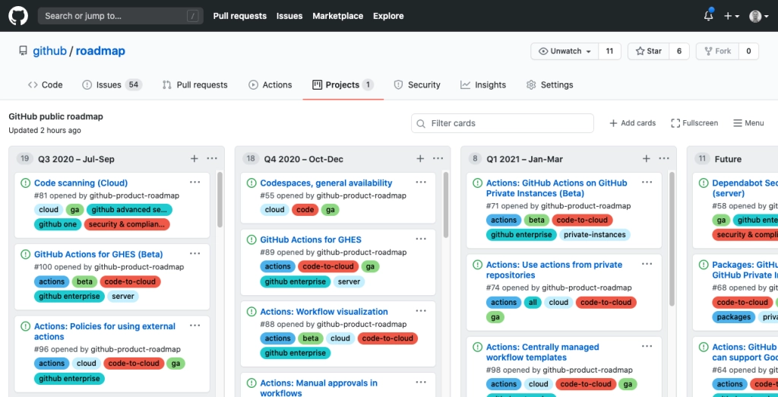
GitHub Public Roadmap
https://github.com/github/roadmap/projects/1
Give your team more information about what features and functionality you can expect from GitHub over the coming quarters.
With more transparency into what we’re building, you can also plan better.

Slide 48
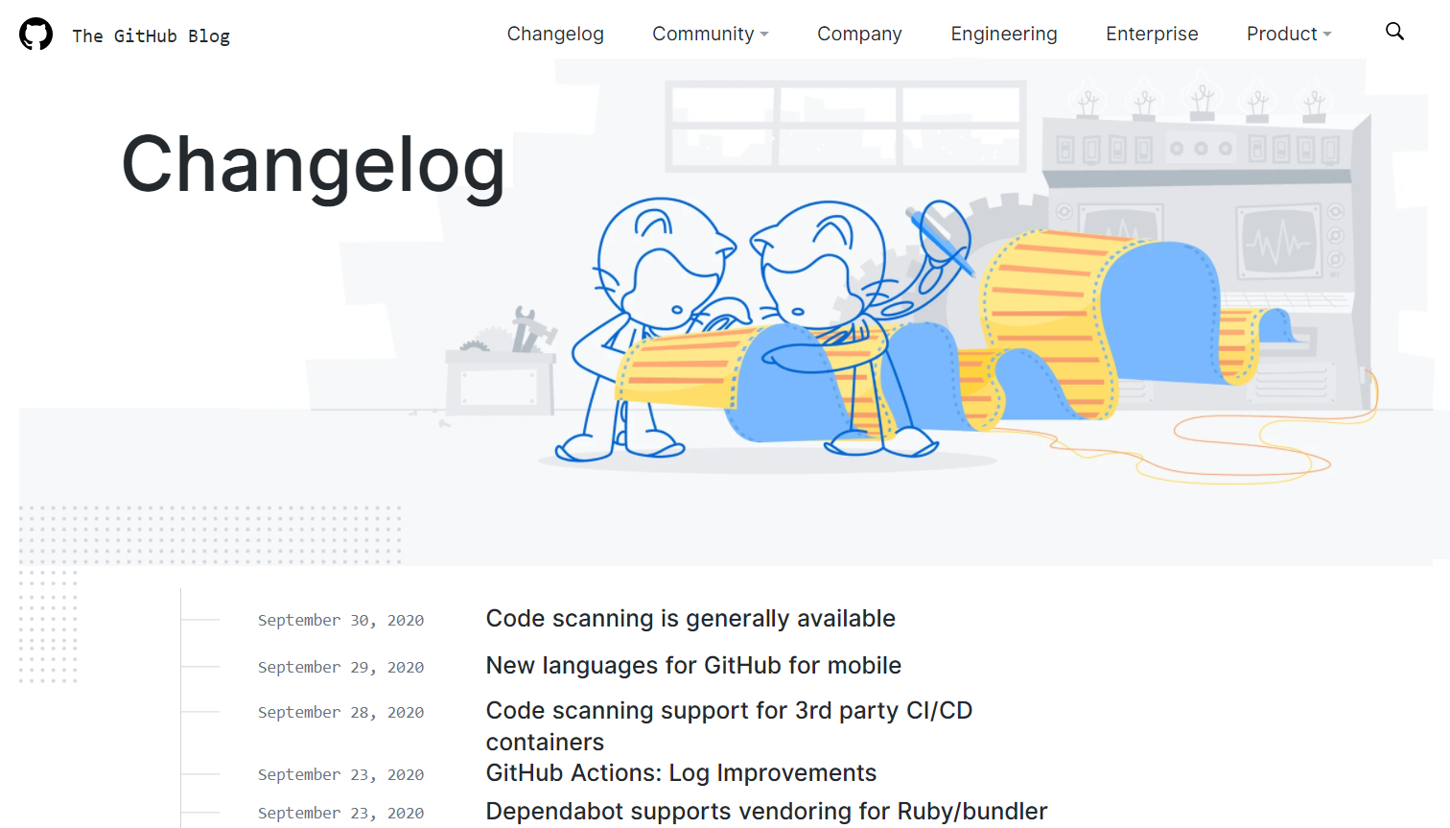
GitHub Changelog
https://github.blog/changelog & https://github.blog/tag/changelog-recap
Track the release of new features. These are the GitHub “Release Notes”.
Go to https://github.blog/ and click on “Changelog”.
Filter the blog posts by items tagged with “changelog recap” to see a monthly Changelog recap
Notes:
Series of blog posts with a monthly recap

Slide 49
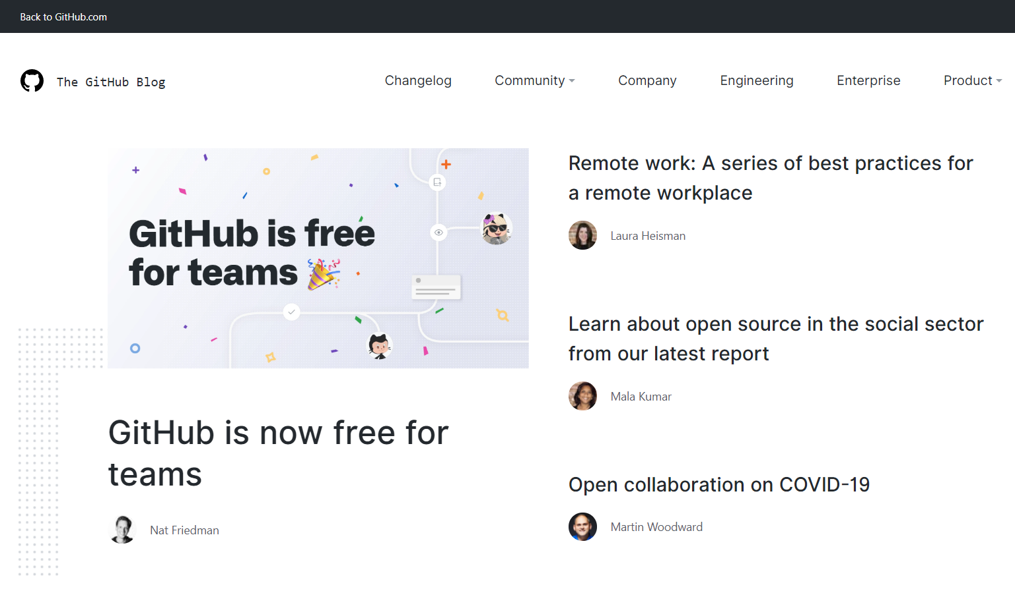
GitHub Blog
Get the latest news on all things related to GitHub
Learn about everything GitHub such as…
Product - New Features, Upcoming Features, Security, Editor tools
Company - Policy, Remote work, Updates
Community - Education, Events, Insights, Open source
https://github.blog/
➔
Notes:
769 x 435, Ratio: 1.767816
BE SURE TO SEND THE PICTURE TO THE BACK AFTER UPDATING THE IMAGE!!
Remove these instructions

Slide 50
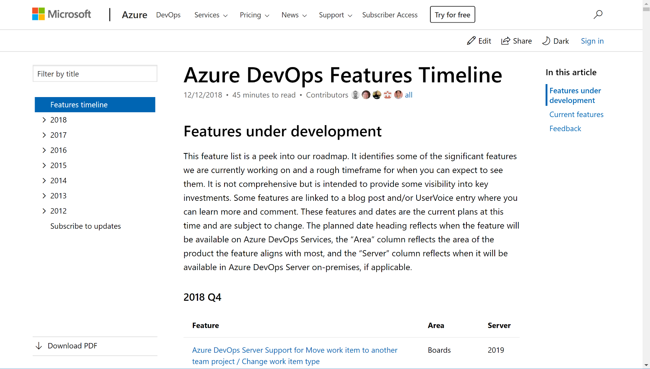
Azure DevOps Features Timeline
https://docs.microsoft.com/en-us/azure/devops/release-notes/features-timeline
Take a peek into our roadmap. See the significant features we are working on and a rough timeframe for when you can expect to see them
We deploy updates frequently. Review the release notes for each three week sprint
Subscribe to this page to get notified when we provide new release notes and roadmap updates

Slide 51
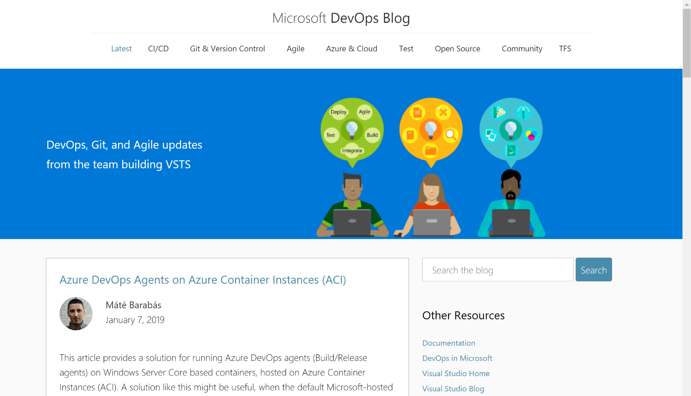
Azure DevOps Team Blog
Get the latest news from the team that builds Azure DevOps
Learn about new and upcoming features
Get a weekly listing of the top Stories from the Microsoft DevOps Community
Look for past posts on specific topics such as CI/CD, Git, Open Source, etc.
https://Blogs.MSDN.Microsoft.com/DevOps/
➔
Notes:
769 x 435, Ratio: 1.767816
BE SURE TO SEND THE PICTURE TO THE BACK AFTER UPDATING THE IMAGE!!
Remove these instructions

Slide 52

Resources to Learn More

Slide 53
Presenter guidance – Resources to Learn More
Title | Resources to learn more
Main Objective | Leave the customer with these resources.
Usage Guidance | Your presentation has excited them so much they are going to want to dive in and learn more as soon as the meeting has ended. Save this deck as a PDF file and work with the account team to get this to your customer.

Slide 54
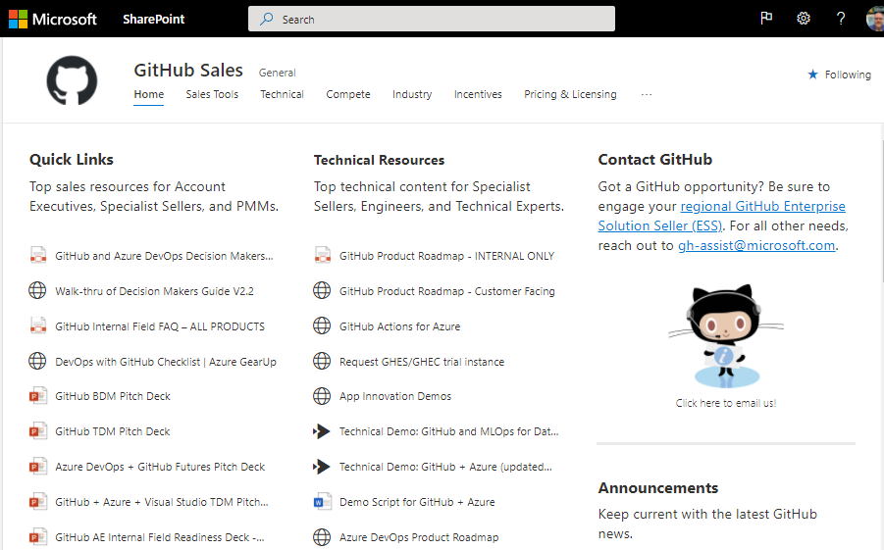
GitHub Resources for Microsoft Employees
Get the latest internal news on all things related to GitHub
Learn about everything GitHub such as…
Quick Links - Top sales resources for Account Executives, Specialist Sellers, and PMMs.
Technical Resources - Top technical content for Specialist Sellers, Engineers, CSAs and CEs.
Training & Videos - Watch GitHub sales training and technical demos on MS Stream.
https://aka.ms/GHSales
➔
Notes:
769 x 435, Ratio: 1.767816
BE SURE TO SEND THE PICTURE TO THE BACK AFTER UPDATING THE IMAGE!!
Remove these instructions

Slide 55
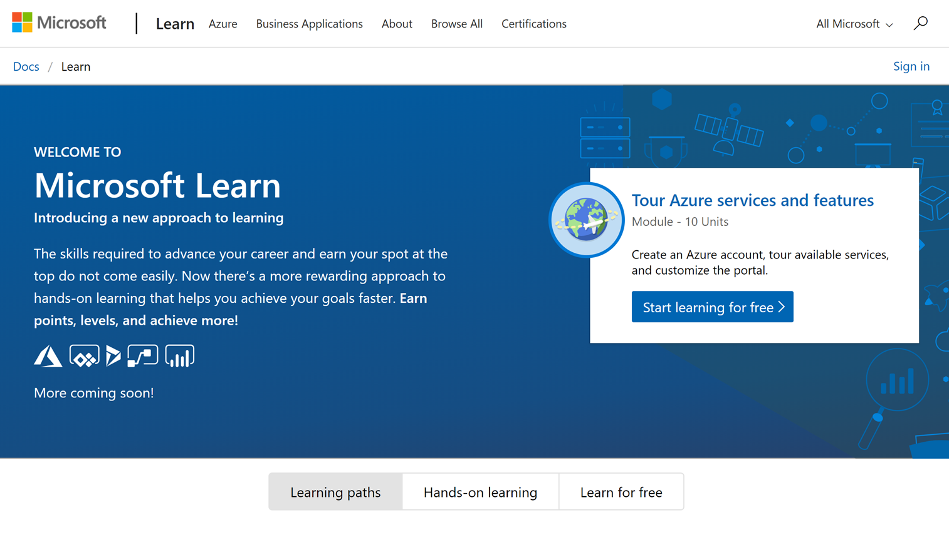
Microsoft Learn
Build your skills fast with free, interactive tutorials at Microsoft Learn, a new training experience for technical users.
Step-by-step training to fit your schedule
Interactive coding environments for hands-on experience
Earn achievements and recognition for your Azure skills
For many modules we provide free Azure sandboxes, free virtual machines, etc. so there is nothing to setup ahead of time
http://docs.Microsoft.com/Learn/
➔
Notes:
Introducing Microsoft Learn – the Best place to start learning Microsoft technologies – Free!
Quickly build skills: interactive, step-by-step bite-size tutorials
Learn by doing: browser-based interactive coding environments for hands-on experience. Free fixed-time access to create and manage Azure resources - no credit card required.
Earn recognition: Track progress, check knowledge, and validate deployments to earn points, levels, achievements, and trophies
Learning aligned to new role-based certifications: easier for you to prepare for certification and be recognized as a leader in Microsoft technologies
Multiple modes of learning: learn in way best for you. select from free self-paced quick tutorials and hands-on learning, to structured online courses free from Pluralsight and instructor led classes from learning partners. Get started by selecting a Learning Path that is closest to your role, e.g. Business Analyst , Azure Developer , Azure Solution Architect . Regarding the individual modules: You can start with the basics such as Tour Azure services and features or go deep with something like Create serverless applications.

Slide 56

Microsoft Learn – GitHub Related Learning Paths
Check out the growing collection of DevOps & GitHub related Learning Paths
Take full control of your GitHub projects. Through work planning and tracking, effective branching strategies.
Extend GitHub through its API, manage releases all the way from idea to working software in the hands of your users
Learn how GitHub Actions enables you to automate your software development cycle and deploy applications to Azure.
Whether you manage enterprise or open-source software projects, learn how GitHub enables you to build communities that foster communication and collaboration while reinforcing recommended guidelines, codes of conduct, and security best practices.
https://docs.microsoft.com/en-us/learn/github
➔
Notes:
Introducing Microsoft Learn – the Best place to start learning Microsoft technologies – Free!
Quickly build skills: interactive, step-by-step bite-size tutorials
Learn by doing: browser-based interactive coding environments for hands-on experience. Free fixed-time access to create and manage Azure resources - no credit card required.
Earn recognition: Track progress, check knowledge, and validate deployments to earn points, levels, achievements, and trophies
Learning aligned to new role-based certifications: easier for you to prepare for certification and be recognized as a leader in Microsoft technologies
Multiple modes of learning: learn in way best for you. select from free self-paced quick tutorials and hands-on learning, to structured online courses free from Pluralsight and instructor led classes from learning partners. Get started by selecting a Learning Path that is closest to your role, e.g. Business Analyst , Azure Developer , Azure Solution Architect . Regarding the individual modules: You can start with the basics such as Tour Azure services and features or go deep with something like Create serverless applications.

Slide 57

Microsoft Learn – DevOps Dojo
Introduce DevOps Dojo: Create efficiencies that support your business
Start your DevOps Dojo journey. Learn how to create multidisciplinary DevOps teams by using shared tools and processes designed to make your organization’s software development and implementation projects more efficient.
https://docs.microsoft.com/en-us/learn/paths/devops-dojo-white-belt-foundation
➔
Notes:
https://docs.Microsoft.com/en-us/learn/paths/devops-dojo-white-belt-foundation

Slide 58

Additional SPARK Session - Make GitHub Real

Slide 59

GitHub Learning Lab
Grow your skills by completing fun, realistic projects. Get advice and helpful feedback from our friendly Learning Lab bot.
Hands-on lessons created by the GitHub community and taught by the Learning Lab bot.
Learn new skills while working in your own copy of a real project.
Our friendly bot provides instructions and feedback throughout your journey.
Real workflow - Everything happens in GitHub Issues and Pull Requests.
https://lab.github.com/
➔

Slide 60

Azure DevOps Hands-On Labs
Learn to plan smartly, collaborate better, and ship faster with a set of modern development services.
Get Hands On Experience with Azure DevOps Services – Learn how you can plan better, code together and ship faster with Azure DevOps Services.
Getting started - These labs will help you to get started with Azure DevOps services to automate software delivery and meet business needs.
Deep Dive into Azure DevOps - Learn how to integrate with popular OSS and 3rd party tools and services. Use the tools and languages you know.
https://www.AzureDevOpsLabs.com
➔

Slide 61

Documentation - GitHub
Discover all of GitHub’s product documentation!
If you only save one Favorite in your browser related to GitHub, this is the link to save as a favorite!
https://docs.github.com/en
➔

Slide 62

Documentation - Azure DevOps
Use this landing page to learn about all the features available in Azure DevOps
If you're new to Azure DevOps Services or Azure DevOps Server, see the Key concepts
For a description of the core services supported through the web portal, see Essential services
If you only save one Favorite in your browser related to Azure DevOps, this is the link to save as a favorite!
https://docs.microsoft.com/en-us/azure/devops
➔

Slide 63

”DevOps Lab” YouTube channel
Learn more about GitHub, Azure DevOps and more through videos
Join the League of Extraordinary Cloud DevOps Advocates in this new show all about DevOps.
We go beyond the buzzword and show you how to solve your DevOps problems using a wide range of tools and techniques.
https://youtube.com/playlist?list=PLNMUSSKcxKjdBYnOCQ8mohwlP3N7t-yHp
➔

Slide 64

Resources to Learn More – Customer Stories

Slide 65
Customer Stories – Security Conscious
Find other Microsoft & GitHub customers like you who are succeeding on their DevOps journey
Postmates
For Postmates’ security team, the benefit of CodeQL isn’t just customization but also automation, which can save them significant time spent combing code for errors. Finding one issue is a start but upon closer inspection, it can unfold into many more variants. A third-party researcher might find an issue, but the same one, or a variant of it, can exist elsewhere in a codebase. “CodeQL adds value by finding variants coming through other channels and in other products,” said Staff Security Engineer David Ross. “It can track data from source to sync, which is particularly useful for things like cross-site scripting vulnerabilities: you can follow their path through your code. It’s possible to find these things by searching certain strings, but to find a lot of them, you need something a bit better—and I haven’t seen anything else like CodeQL.”
McKesson Labs
GitHub makes it easy for developers to address and fix any potential issues in their code. Automated Security Updates send security alerts whenever vulnerabilities are identified, and automatically opens a pull request with the recommended security updates. With GitHub’s Security features, McKesson’s developers can code in confidence knowing their work is secure.
“We’re looking to simplify and modernize our applications to deliver the highest value to McKesson, and more importantly, to our customers,” explained Canty. “GitHub is essential to our journey to become more agile as we build applications into the future.”
http://aka.ms/AzureDevOpsCustomerStories & https://github.com/customer-stories?type=enterprise
➔

Slide 66
Customer Stories - Healthcare
Find other Microsoft & GitHub customers like you who are succeeding on their DevOps journey
McKesson Labs
GitHub makes it easy for developers to address and fix any potential issues in their code. Automated Security Updates send security alerts whenever vulnerabilities are identified, and automatically opens a pull request with the recommended security updates. With GitHub’s Security features, McKesson’s developers can code in confidence knowing their work is secure.
“We’re looking to simplify and modernize our applications to deliver the highest value to McKesson, and more importantly, to our customers,” explained Canty. “GitHub is essential to our journey to become more agile as we build applications into the future.”
Sentara Healthcare
Sentara began presenting huge volumes of Epic data with the compute power of Azure Kubernetes Service (AKS) and shifting the Epic environment to M-series Azure Virtual Machines, initially for Clarity and Caboodle. It also started testing disaster recovery and training in those environments. To support these data projects, the organization used Azure DevOps to apply DevOps methodologies and continuous integration and continuous development (CI-CD) practices to its development and delivery processes.
“By using the CI-CD pipelines in Azure DevOps, we quickly made all the appropriate changes necessary to ensure a high level of security and deploy changes smoothly—at a time when it was more important than ever to help our employees help patients,” says Jeff Thomas, VP and CTO.
http://aka.ms/AzureDevOpsCustomerStories & https://github.com/customer-stories?anchor=results&industry=healthcare&type=enterprise
➔

Slide 67
Customer Stories – Banking & Financial Services
Find other Microsoft & GitHub customers like you who are succeeding on their DevOps journey
Societe Generale - “Amir Jaballah and Societe Generale choose GitHub Enterprise. Today, thousands of employees have adopted GitHub across their global organization. And in just a few years, Societe Generale has automated workflows, tripled their releases, cut development time by more than half, and improved employee retention.”
Fastmarkets - “You want to focus your engineering dollars on building software that’s going to impact your customers, not building infrastructure. The more you can have your engineers focus on building great product functionality, the more value you’re getting for them and the better ROI you’re getting. It’s possibly the number one reason I’d favour Azure over anything else.” Kevin Smith: CTO
Van Lanschot - "With our on-premises environment, we could never have done what we did as quickly and as cost-effectively as we did with Microsoft Azure and Azure DevOps. They helped us cut the development cycle by about 50 percent." Olaf Surewaard: IT Architect
Nubank - “Our engineering organization at Nubank relies on GitHub. Everything related to business logic is over there in source code,” said Infosec Tech Manager Victor Haberkorn Gomes. “It’s really the heart of the company. Everything starts there.” Victor Haberkorn Gomes: Infosec Tech Manager
http://aka.ms/AzureDevOpsCustomerStories & https://github.com/customer-stories?anchor=results&industry=financial-services&type=enterprise
➔
Notes:
Banking and Finance

Slide 68
Customer Stories – Insurance
Find other Microsoft & GitHub customers like you who are succeeding on their DevOps journey
Nationwide - “We knew we were going to save money, but that savings immediately turned into more capacity for teams to do the most valuable work for our business.”
The Hartford - “Our development teams have benefited from the collaborative features of GitHub. It allows them to take co-development to a whole new level by working as a community and maturing our innersourcing practices,” said Tan “The GitHub platform has enabled us to exponentially raise the productivity of our developers and position us to meaningfully contribute back to the open community.”
IAG - “Using GitHub allows us to support distributed development and an automated pipeline. This has accelerated the speed of development and allowed us to focus on the work that matters.” said Kieran Clulow, director of data engineering and architecture. “Taking the spirit of open source and applying it to our internal workflows has broken down silos across the organization and made GitHub a powerful tool for collaboration”
Geico - “With DevOps and Azure, we’re able to reduce our new-feature release cycle down to one week, and we think we can even speed that up.”
http://aka.ms/AzureDevOpsCustomerStories & https://github.com/customer-stories?type=enterprise
➔
Notes:
Insurance

Slide 69

Questions?
Jim Blizzard jim.blizzard@microsoft.com

Slide 70


Survey
Please fill out the Azure Dev Day Survey!
https://aka.ms/azuredevdaysurvey

Slide 71
GitHub Lab
Deploy using GitHub Actions
GitHub (Actions)
App Service
https://aka.ms/azuredevdaylabs

